Slide 1
Managing The Mobile Enterprise

Slide 2
Mobile Device Management
Spirit Overview:
Enterprise Mobility Solution Specialist
Mobile Device Management
Managed Services
Mobile Computing Hardware
CSOLS Partnership
Notes:
Control applications, websites and features your mobile device has access to

Slide 3
SOTI MobiControl.
SOTI MobiControl is an end-to-end enterprise mobility management solution that seamlessly manages mobile devices, applications, content, and security from within a single management console.

Slide 4
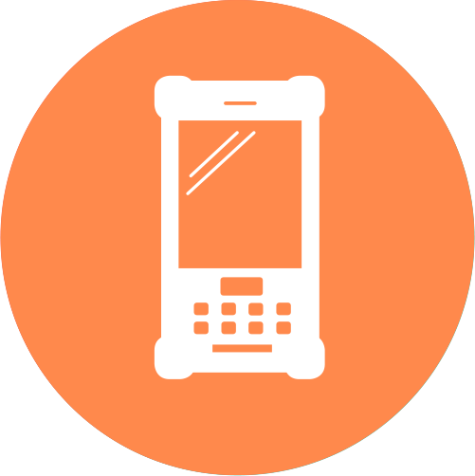
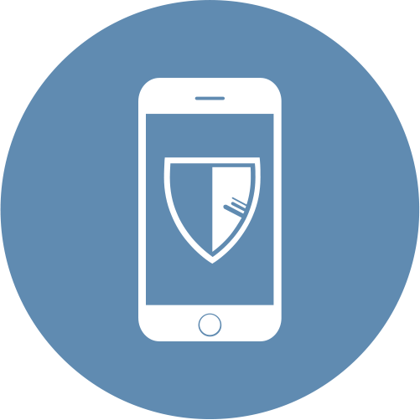
mobility management across all endpoints.
Purpose-Built Rugged
Corporate Liable
BYOD
Internet of Things (IoT)

Slide 5
from deployment to retirement, SOTI makes it easy to manage mobile devices.
Provisioning
Enrollment
Management
Security
Content
Applications
Retirement

Slide 6
multi-OS compatibility.
SOTI is completely device and operating system agnostic.
Android Management
Apple Management
Android Management
Windows Management
MobiControl is built as a generic modular framework HTTPS | SSL | SQL/ODBC | OMA-DM

Slide 7
SOTI MobiControl features.

Slide 8
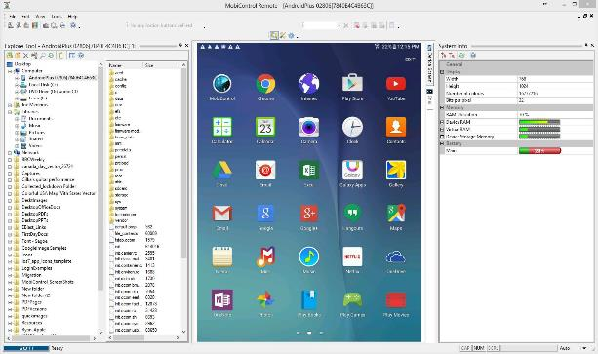
real control & remote view for live, real-time support.
MobiControl’s Remote Control is the fastest and most reliable interactive remote control of Android and Windows devices for optimal Help desk capability and troubleshooting, as well as remote view and advanced device management available for iOS devices.
Best-in-class remote helpdesk capabilities offer administrators the ability to support their growing mobile workforce effortlessly.

Slide 9
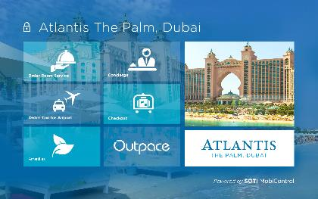
kiosk mode lockdown.
Customised mobile device home screens.
Provides intuitive and customizable “Kiosk” interface for Windows and Android™ devices
Limits applications, documents and web resources as predefined by Administrator
Improves productivity for dedicated-use environments such as Utilities, Logistics, Hospitality, Education etc.
Blocks access to device configuration parameters thereby reducing support costs
Notes:
Control applications, websites and features your mobile device has access to

Slide 10
location-based services-Geofencing.
Geographical boundaries for enterprise mobility.
Enhances location-based services by enabling the monitoring of mobile devices with geofence alerts
Defined actions can be executed automatically when devices enter or exit pre-specified geofenced areas
Additional capability to retrieve the postal address of any device's current location, send driving directions to the mobile device from the helpdesk and access live traffic condition reporting
Help track lost or stolen devices and shut down a device once it is determined non-retrievable

Slide 11
proactive expense management.
Keeping tabs on telecom expenses.
Includes intelligent usage policies for monitoring and managing voice and date usage
Enterprise IT can setup up thresholds that trigger notifications for users that exceed predefined voice/data allocations
Hard thresholds can be implemented to disable SMS/MMS messaging, turn off data or even restrict calling
Powerful reporting features allow detailed analysis of device and application level

Slide 12
application management.
Empower employees with corporate applications.
Applications are one of the main drivers behind the success of business mobility
Application management can be extremely complicated; provisioning what apps are allowed on what device, managing updates, configuring settings, all of these activities are required on a regular basis
SOTI delivers a comprehensive suite of mobile application management features
Notes:
It started with simple apps like email and calendaring and today businesses rely on mobile Line-of-Business (LOB) applications, ERP and SFA solutions to empower their mobile workers and keep them productive on the road.

Slide 13
antivirus/malware built in.
Be vigilant against evolving mobile threats.
Protect mobile device assets and keep corporate content private and reduce worker downtime
Monitor device file system and installed applications for malware and viruses
Quarantine infected applications and files on devices
Schedule antivirus scanning, virus definition updates, and quarantine management
Configure antivirus whitelists

Slide 14
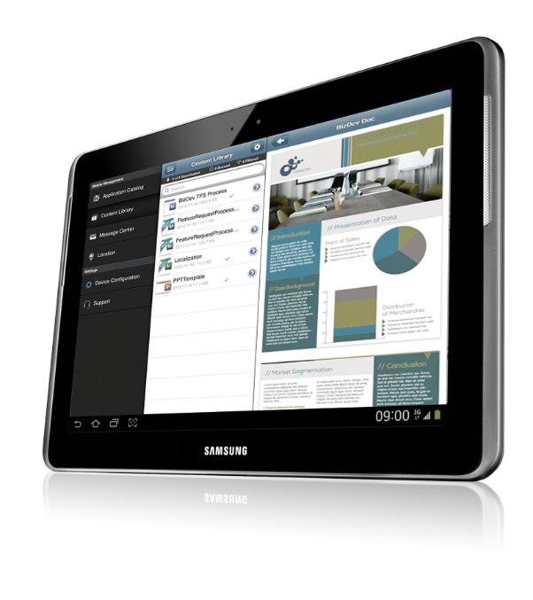
app package delivery.
Deploy apps with no integration.
Deliver the right application to the right employee on the right device, quickly and securely
Corporate applications can be installed silently and deployed without any employee interaction
Keep your employees up-to-date and productive without interruption
Silent Package Deployment
Mandatory apps pushed to device without requiring user interaction

Slide 15
enterprise app catalog.
IT approved marketplace and corporate applications.
Enables managing and updating IT approved marketplace and corporate applications
MobiControl integrates with Apple® App Store and Google Play Store programs like the Volume Purchase Program to handle paid market applications
MobiControl administrator can also configure application whitelists / blacklists and policy violation actions for better mobile user productivity

Slide 16
web filtering.
Control web content users can access.
Enforce and control web access policies to ensure secure, safe and authorized access to web content
Configure web filtering policies to block access to specific URLs
Specify a URL for device redirection
Create a whitelist of acceptable URLs

Slide 17
Content.
Secure access to corporate content.
Mobile workers need access to company content; reports, forms, files and data wherever they are
SOTI delivers two options for the managed distribution of corporate content:
SOTI Content Library – Access content through the MobiControl Agent
SOTI hub – A completely managed and secured content repository
All content transactions are recorded for compliance reporting

Slide 18
advanced self service portal.
No more waiting in support queues.
Self-serve access for individual users to enroll, lock, locate, wipe, reset passwords and send messages to their devices
Reduces support calls, management costs, improves user experience, employee efficiency

Slide 19
Benefits of implementing Mobi Control
Maintain full control of the business mobile devices
Robust device security
Increased mobile user productivity through reduction of device downtime
ROI – increased productivity and reduction of mobile support costs

Slide 20
thank you.

