Slide 1
Remote Sampler Enhancements
RSF II - Kevin Jones CSols Ltd March 2017 Commercial in confidence

Slide 2
Remote Sampler Enhancements
Enhancements – feature/function that we think might be useful for the next software release or is offered as an option
Useability – help with less clicks, reduces data entry
Regulatory – driven by external regulator
Operational – required by local business

Slide 3
Remote Sampler Enhancements
1. Collection run constraints Application of rules to collection runs before assignment e.g. to check runs can be completed with existing resources (e.g. within certain time, using certain sampler skill set, etc). Also, to ensure repeat visits at different times & out-of-hours frequency. (i.e. Out of Hours (OOH) and Operator Self Monitoring (OSM)).

Slide 4
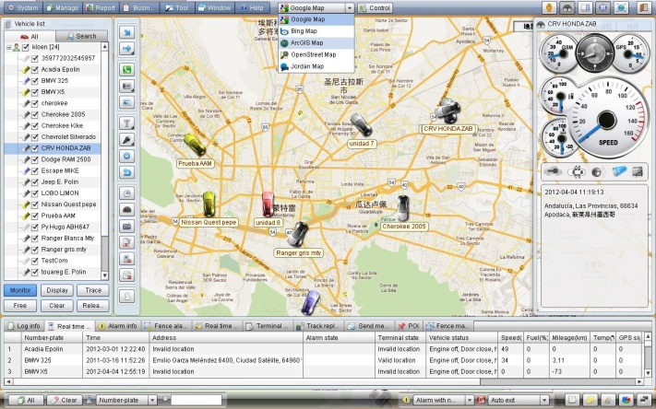
Remote Sampler Enhancements
2. Live display of sampler positions Map display showing current GPS position of all (or group) of samplers and whether in communication range and/or inactivity.
3. Transfer of site documents/information Download of relevant site information during assignment e.g. map of site, access information.

Slide 5
Remote Sampler Enhancements
4. Alert handling Email and text message alerting for key events in the sample lifecycle..
5. AQC Handling Further functionality required during measurement, feedback or results/sample acceptance
6. Voice recording Option to use voice recording during sampling or site visit and so added to custody trail

Slide 6
Remote Sampler Enhancements
7. Intelligent scheduling engine Allow Remote Sampler to control sample scheduling to optimise the sampling workload across the sampling team taking into account regulatory constraints, out of hours sampling, sample point location and other constraints. (Replace Water Management Module)
8. Report Builder A visual report builder to enable the user to create custom reports from any data held in Remote Sampler.

Slide 7
Remote Sampler Enhancements
9. Single sign on capability Log on to Remote Sampler using integrated Windows authentication to prevent multiple password entry screens.
10. Support for RFID Allow bottles and locations to be scanned in Remote Sampler using RFID tags rather than printed barcodes.

