Slide 1
Remote Sampling Forum II - Introduction
RSF-II Kevin Jones CSols Ltd March 2017 Commercial in confidence

Slide 2
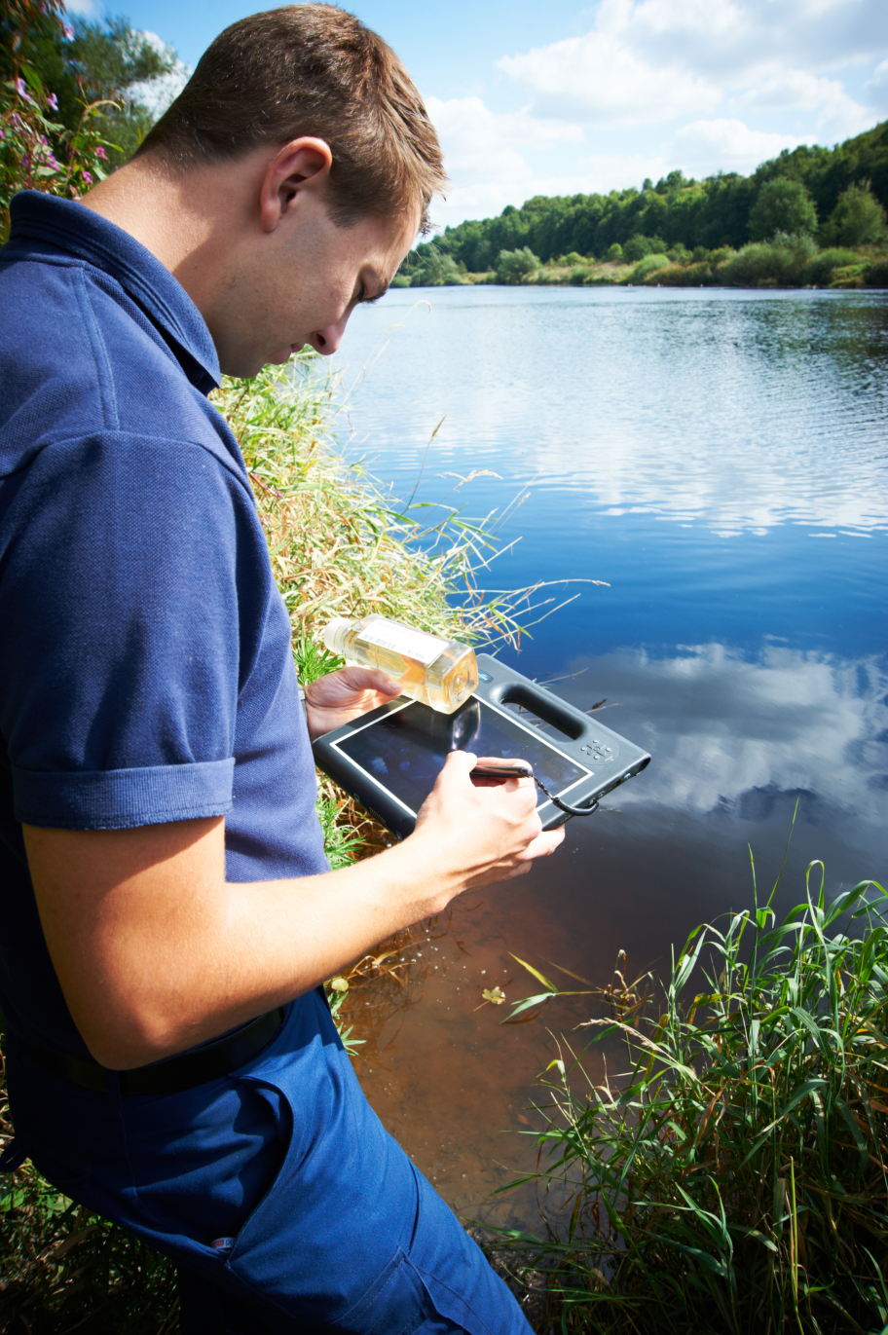
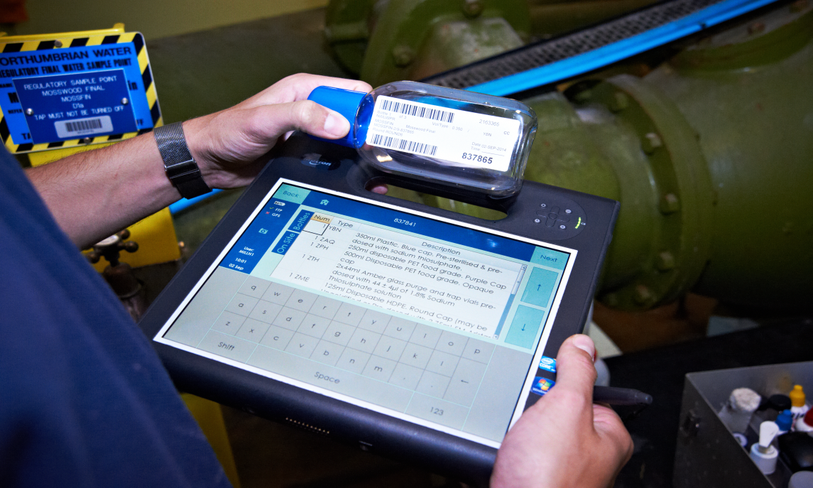
Welcome
Remote Sampling Forum II 2017
The Heath Research & Technical Centre Runcorn
Notes:
Housekeeping/ room were’ in etc

Slide 3
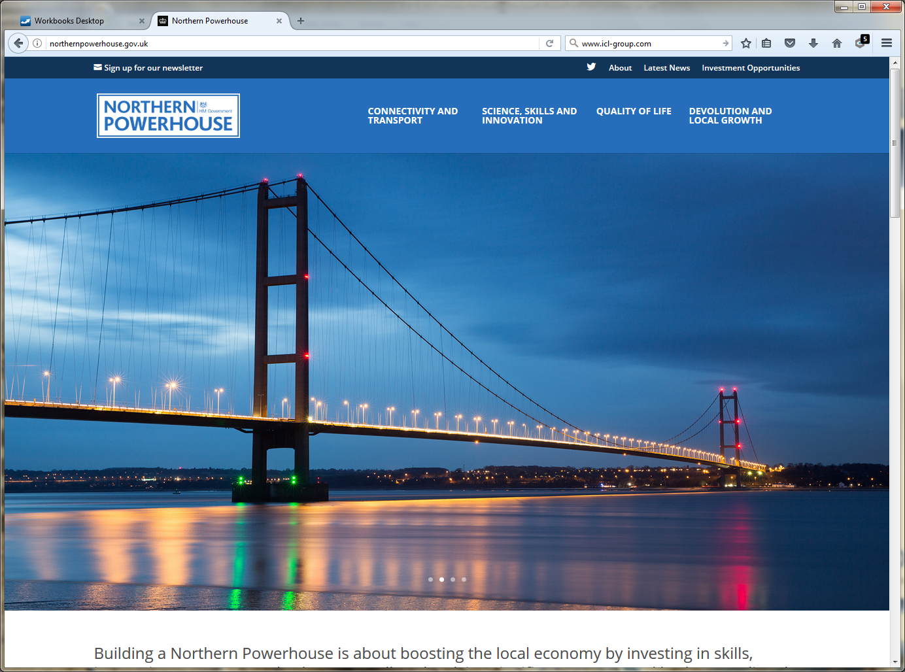
Northern Powerhouse

Slide 4
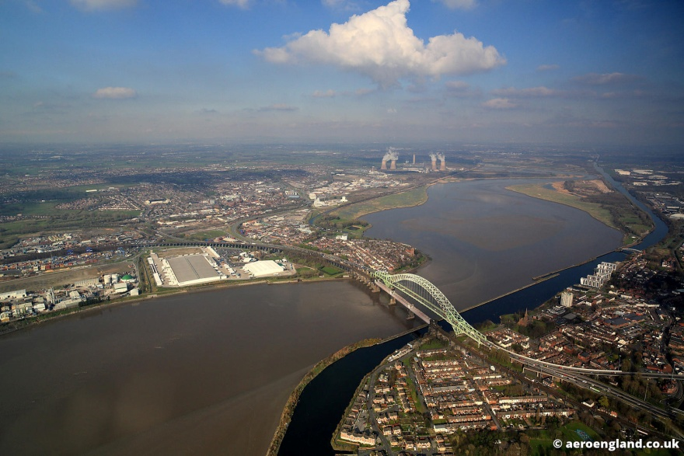
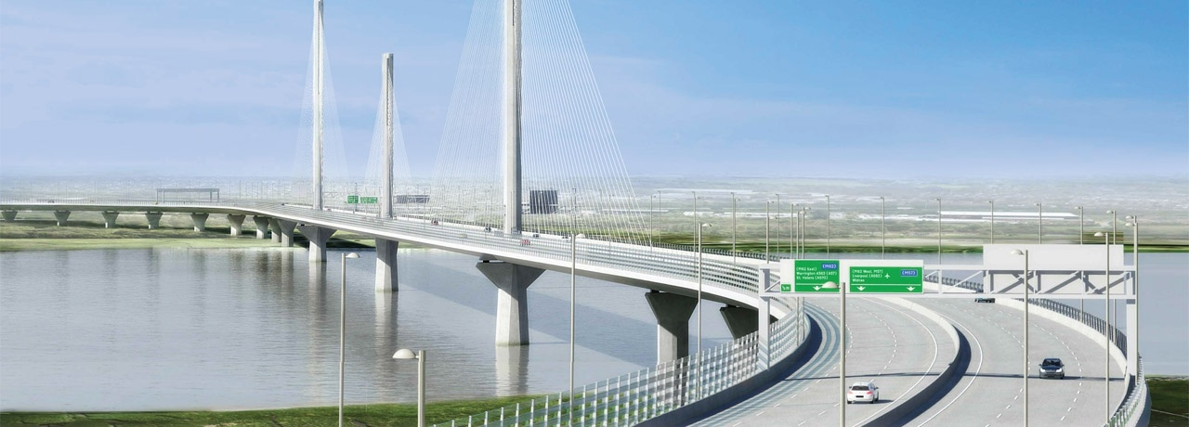
Runcorn

Slide 5
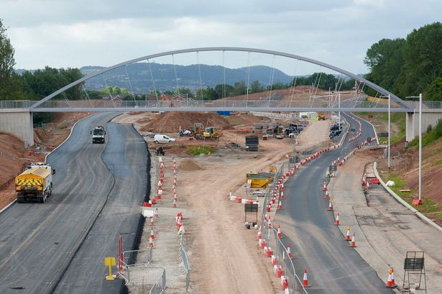
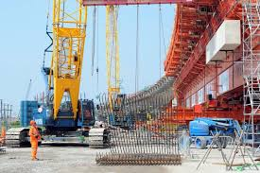
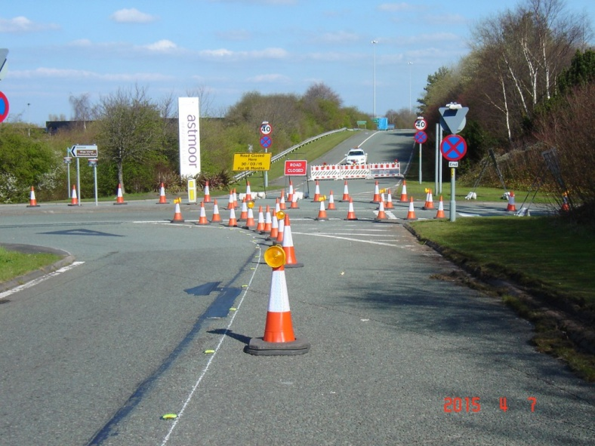
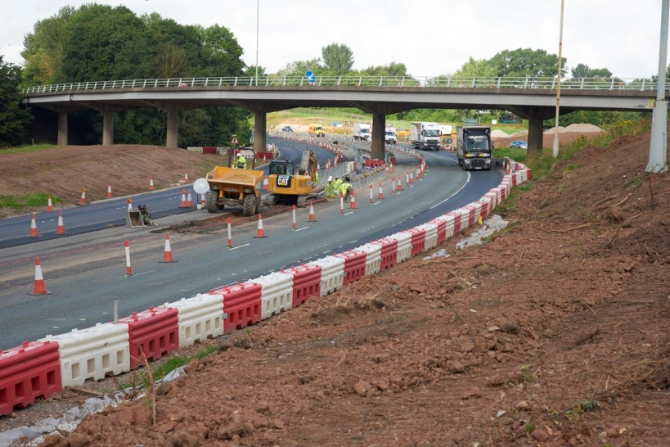
Runcorn now Runcone

Slide 6
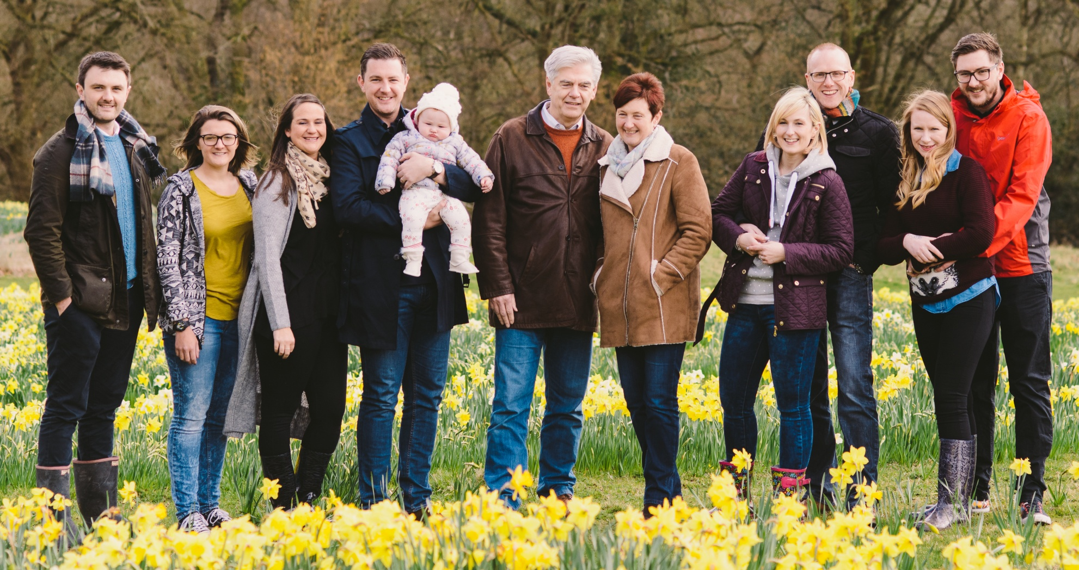
Kevin Jones

Slide 7
Introductions - Hosts
Kevin Jones – CSols Sales Manager
Keith Huxford – CSols Sales & Marketing
Sam Goddard – CSols Remote Sampler Manager
Gavin Meredith – CSols Remote Sampler Developer
Cedric Mochon – CSols Specialist
Jessica Matthews – CSols Office Manager
Kate Waddington – CSols Application
Kevin Thomas – Spirit Data Capture
Andy McKenna – Spirit Data Capture
Frits van Calker – RFID Direct
Andy Ho – RFID Direct

Slide 8
Guests

Slide 9
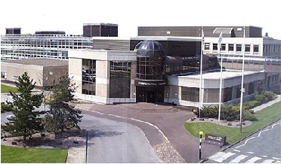
The Heath
Remote Sampler Forum II 2017
The Heath Research & Technical Centre Runcorn
Notes:
Housekeeping/ room were’ in etc

Slide 10
Agenda am.
09:45-10:00 Registration and coffee
10:00-10:05 Welcome and introductions Kevin Jones, CSols
10:20-10:40 What’s new with Remote Sampler in 2017 Sam Goddard, CSols
- Cloud and new device support
10.30 -10.50 Coffee
10:50 -11:30 Hands on workshop – Product demonstrations All
and a chance to get hands on with handheld Remote Sampler devices
11:30-12:00 New device implementation & remote Kevin Thomas
support options Spirit Data Capture
12:00-13:00 Lunch

Slide 11
Agenda pm.
13:00-13:20 User talk Gareth Maxwell, LIMS and Compliance Manager, Northern Ireland Water
13:20-13:40 User talk Remote Sampler at Northumbrian Water
14:40-14:10 Introduction to RFID, Bottle/ Frits van Calker, RFIDdirect crate scanning using RFID technology Ltd, Keith Huxford, CSols , Cedric Mochon, CSols 14:10-14:45 Vertical Audits, Traceability, Field AQCs Kevin Jones, CSols
14:45-15:15 Remote Sampler Enhancements Kevin Jones, CSols
15:15-15:30 Coffee
15:30-15:45 Q&A and wrap up/Further demonstrations All on demand

Slide 12
Collatorel
White papers
Brochures
Enhancement list

Slide 13
Forum – why?
Technologies have progressed and are waiting to be used in this setting, in particular, mobile technologies, RFID tagging and cloud computing
Globally Laboratories spend almost $100B pa on Instruments, consumables, and all the other items needed to make them operate smoothly. Add in employees, buildings, taxes and all the other costs, then the number must be closer to $500B.

Slide 14
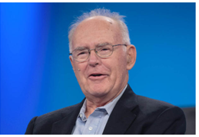
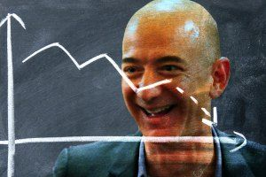
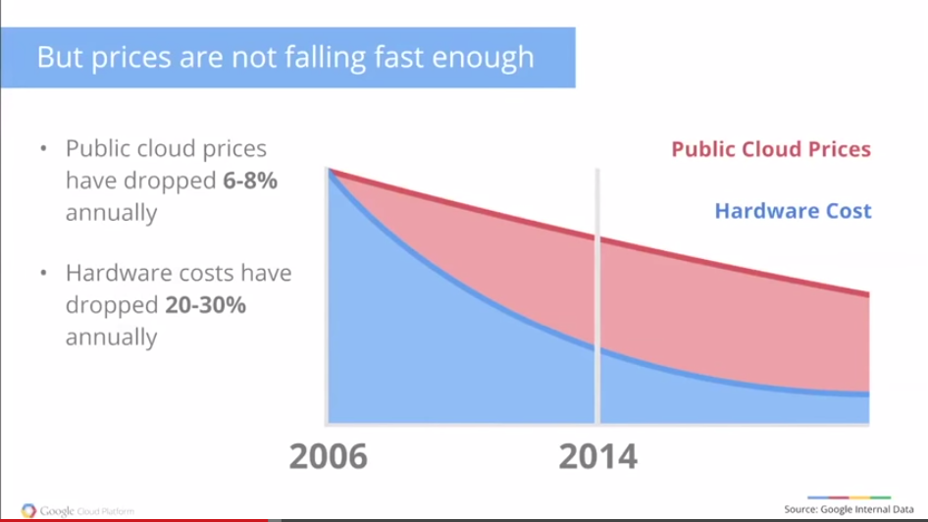
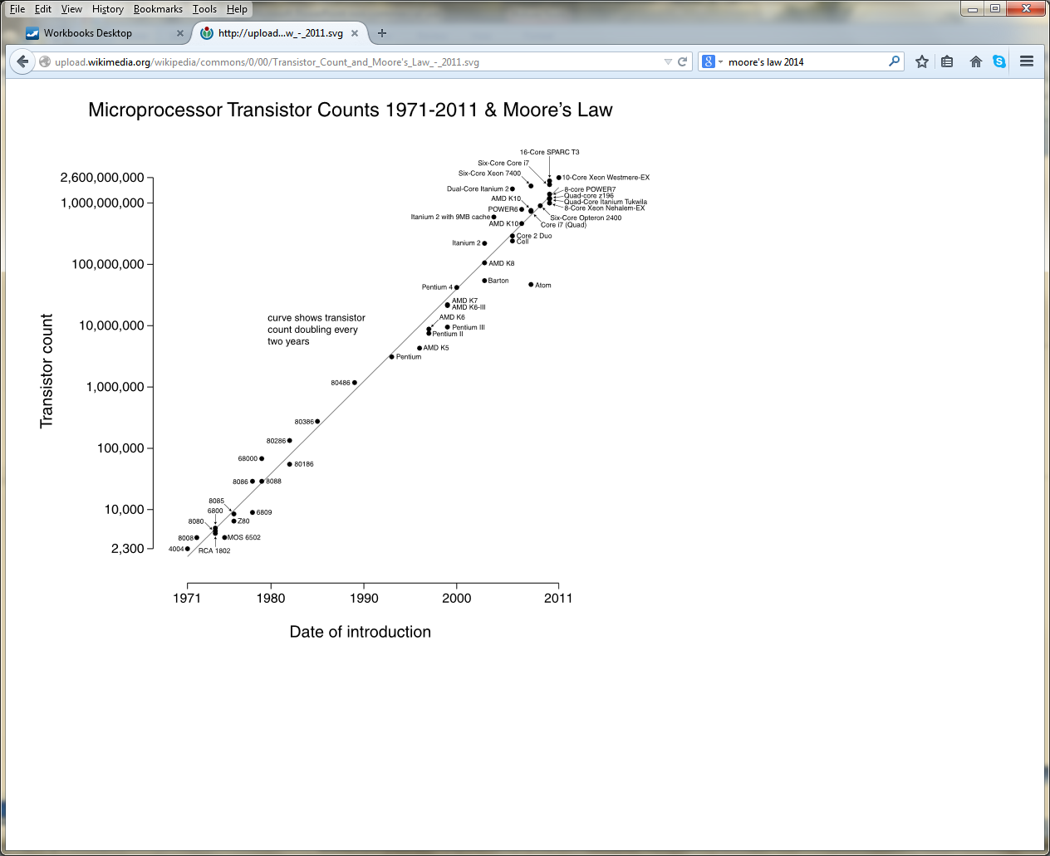
Forum – why? Cloud computing
… if Jeff Bezos’ law reflects reality, the only conclusion is that most enterprises should dump their data centers and move to the public cloud, thus saving money. Some savings occur over time by buying hardware subject to Moore’s Law, plus the fixed cost of maintenance, electrical power, cooling, building and labor to run a data center. In the end, I’ll show how prices are reduced by about 20 percent per year, cutting your bill in half every three years.
Moore's law is the observation that, over the history of computing hardware, the number of transistors on a dense integrated circuit doubles approximately every two years.
- Gordon Moore, Intel

Slide 15
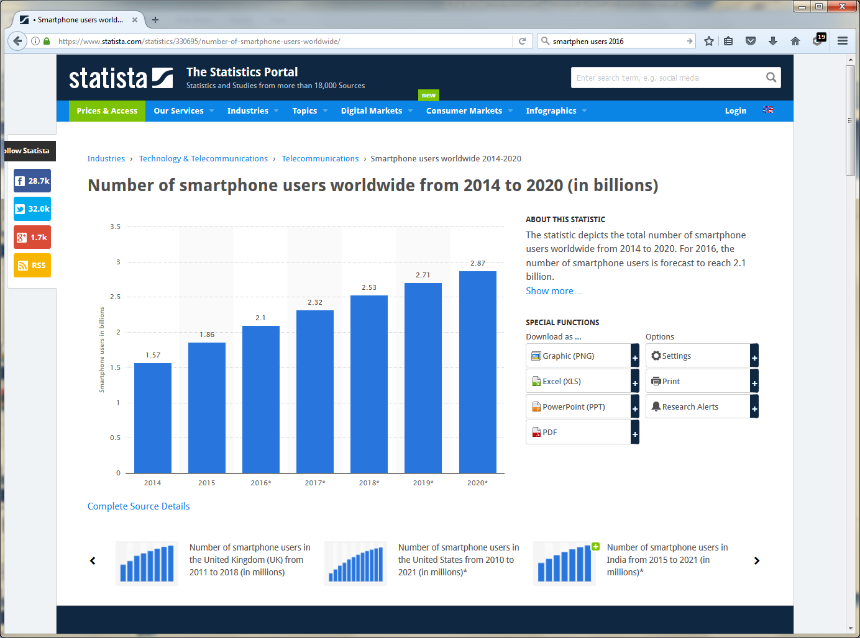
Forum – why? Mobile technologies

Slide 16
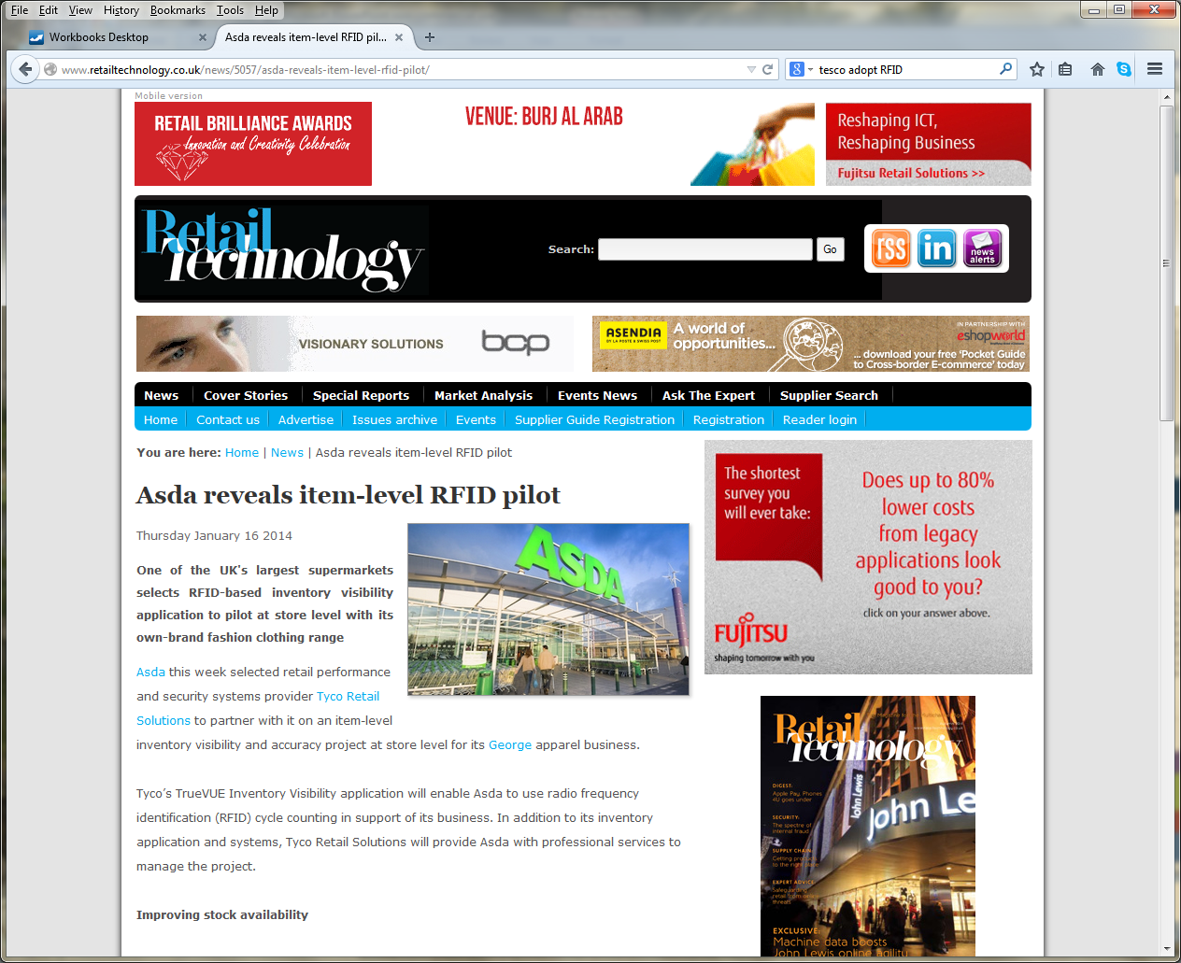
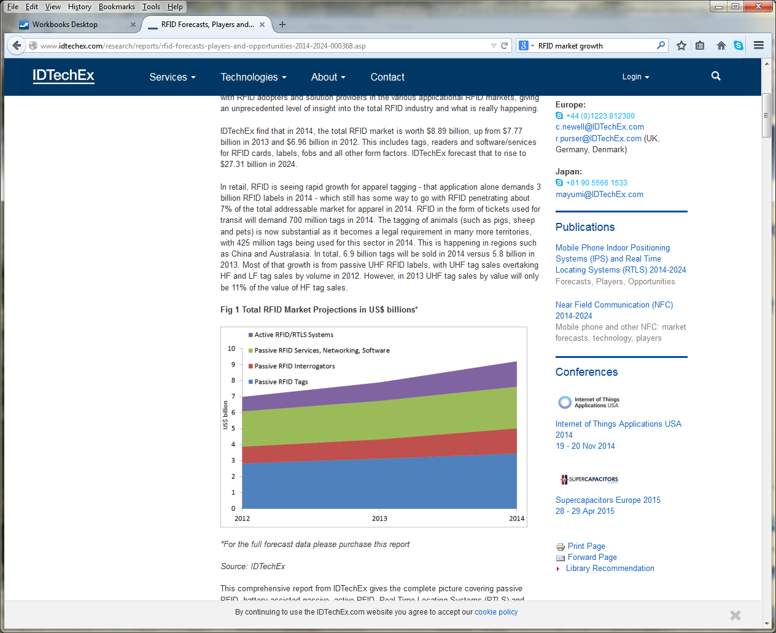
Forum – why? RFID tagging
Survey suggests market growing 10% per annum
Asda running UK pilot for RFID tagging on clothing

Slide 17
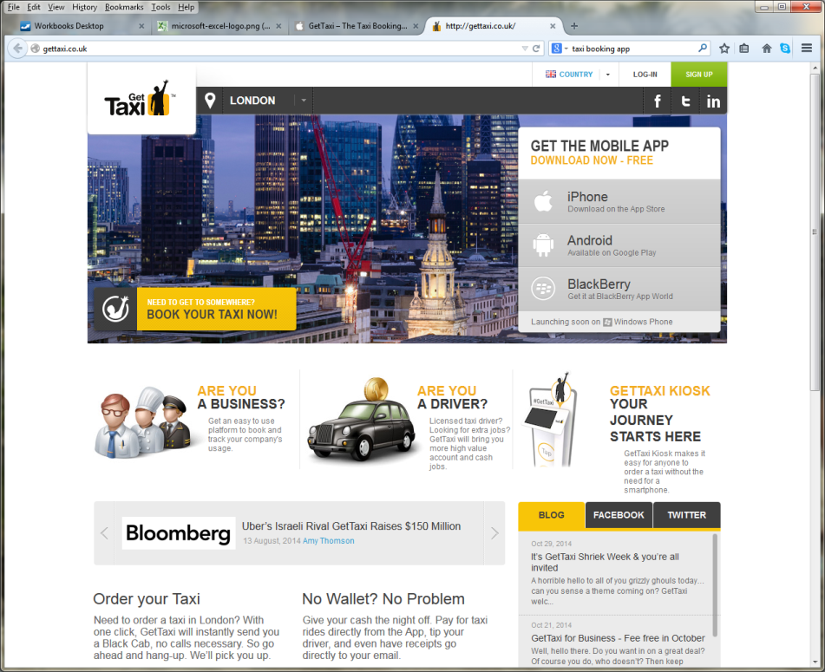
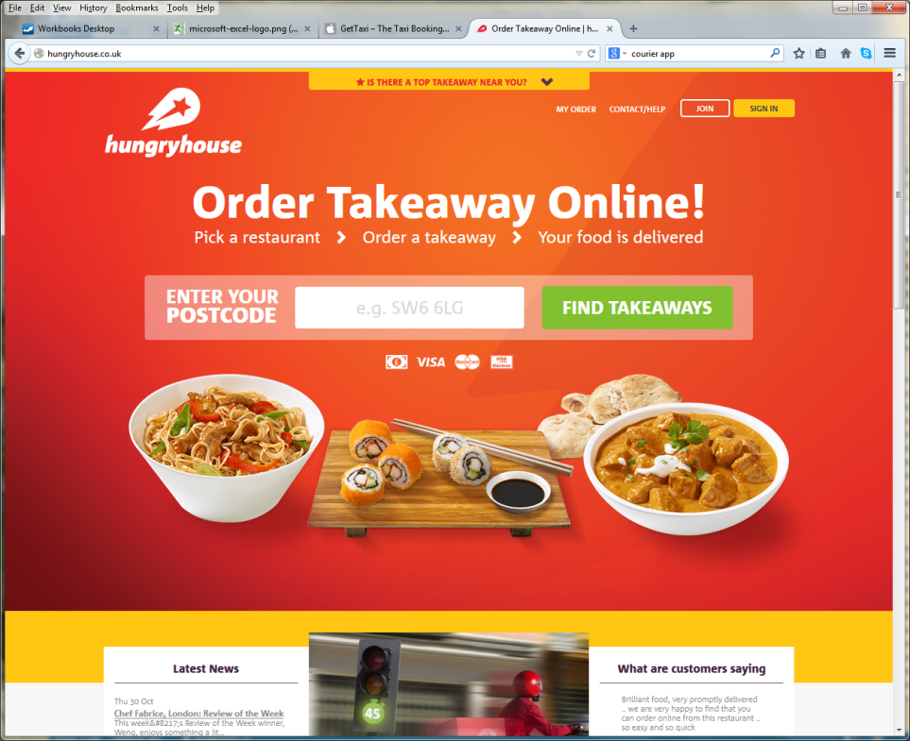
Forum – why? Or in other words…
So then…why is it that you can order a taxi and see where it is, or order a pizza/kebab anywhere, from your phone……what might you be able to do …

Slide 18
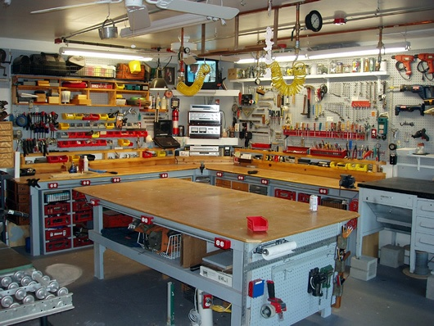
Forum / Workshop / User Group?

Slide 19
Forum?
Chance for you to see/discuss a range of technologies & meet a collection of experts, focussed around the process of sampling, all in one place/one venue
Chance for hands on, ask questions, give your opinion, learn something new, in an informal setting
There’s no such thing as a silly question
Your ideas/thoughts are much appreciated

