Slide 1
Vertical Audits, Traceability, Field AQCs
RSF II - Kevin Jones CSols Ltd March 2017 Commercial in confidence

Slide 2
Vertical Audits, Traceability, Field AQCs
Field AQCs
Reporting - Management Metrics/KPIs - Vertical auditing

Slide 3
Field AQCs
Field AQCs
“Using the current DWTS accredited and competent persons, it is proposed that personnel within each company
Undertake QC of on-line measurements, with respect to chlorine and turbidity. This means that the requirements of
training and competency, audit, traceability of measurement etc. are fulfilled by the existing accreditations. The
outcome of both methods in using a DWTS competent person is to regularly measure, record the differences
between the two readings and employ control chart methodologies with a view to proving statistical parity of
measurements. Some differences in frequency of measurement, methodology and standards for chlorine and
turbidity will be expected. e.g.
For chlorine,
- DWTS certified method that is QC controlled in line with the requirements
- Undertakes regular measurement and compares this to the on-line measured value
- Appropriate frequency in the order of 52 times per year due to the stability of measurement.
For turbidity
- Undertakes regular measurement of a certified set value solid standard
- Frequency TBC but in the order of 12 times per year due to the stability of measurement (physical measurement, stable
(LED) light sources, fixed geometry, non-contact*) and risk associated with regular intervention on the measurement cell
reducing accuracy. “
- DWTS letter November July 2015

Slide 4
Field AQCs - Interpretation
Interpretation - Each sampler takes two Chlorine measurements per day of the AQC material, during normal processing.

Slide 5
Field AQCs -
Possible Solution #1
Capture chlorine results with Remote Sampler mobile during off line workflows
Transfer data from Remote Sampler database to AqcTools
Chart and review data using AqcTools

Slide 6
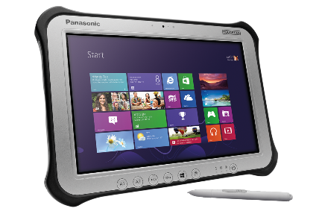
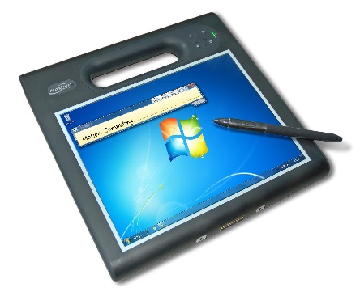
Field AQC - Infrastructure
AqcTools Server & Database
Lab (on premise)
Field
Remote Sampler Server & database
(Cloud or on premise)

Slide 7
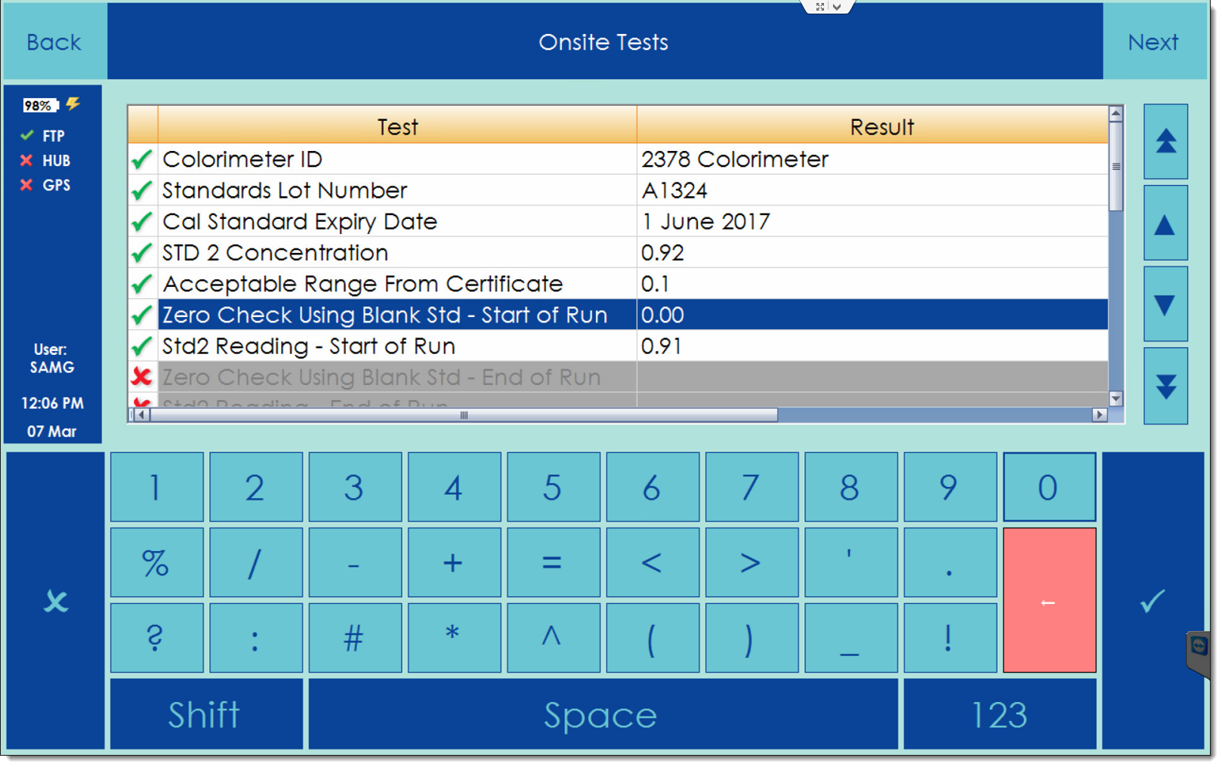
Field AQC – Screen entry

Slide 8
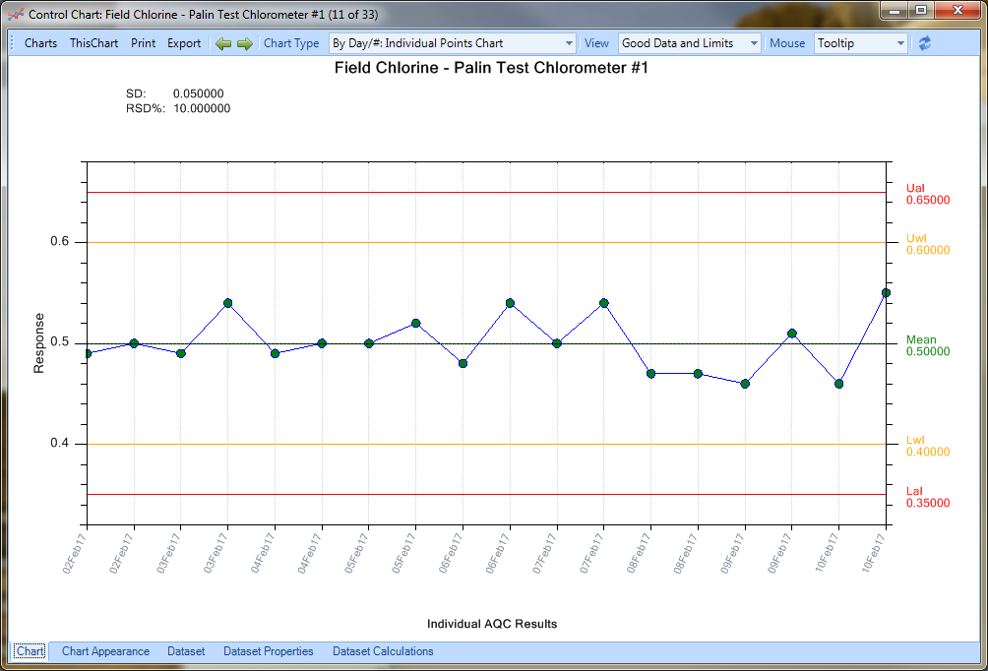
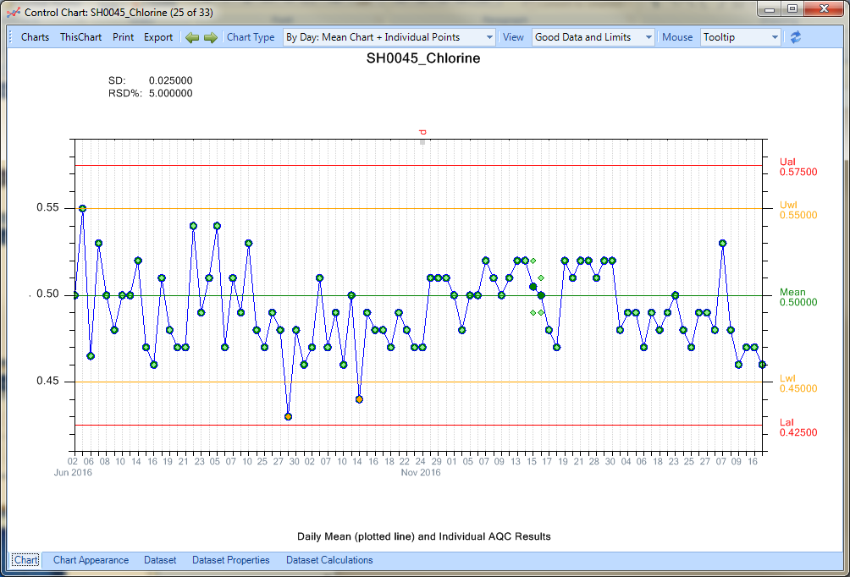
Field AQC – Chart

Slide 9
Field AQCs -
Possible Solution #2
Capture chlorine results with Remote Sampler mobile during off line workflows
Hold update of AQC AND day’s worth of data until 2nd AQC complete and OK, otherwise ….
Transfer data from Remote Sampler database to AqcTools
Chart and review data using AqcTools

Slide 10
AqcTools Demonstration

Slide 11
Reporting - Management Metrics/KPIs
Plot team KPIs
Data LIMS doesn’t have
Interactive Charting
Export to Word/Excel
Alpha Stage
Notes:
What’s in it for you?
Give you access to the management data that Remote Sampler collects
Saves you time over collating performance stats manually and putting them into Excel
Key metrics like:
Total number of samples completed by a user in a given period
Total number of samples completed by a site in a given period
Cumulative sample completion
Generate
Features
Generates a wide variety of interactive charts
See how well your team are handling the sampling schedule
Breakdown by site
Chart performance statistics for individual users
Control the display colours
Print the charts
Chart data that LIMS doesn’t hold
Integrates fully into Remote Sampler
Copy charts straight into Word or Excel

Slide 12
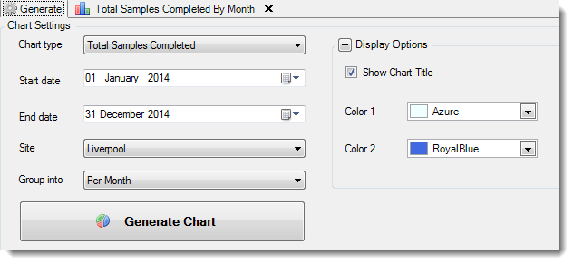
Management Metrics
Notes:
What’s in it for you?
Give you access to the management data that Remote Sampler collects
Saves you time over collating performance stats manually and putting them into Excel
Key metrics like:
Total number of samples completed by a user in a given period
Total number of samples completed by a site in a given period
Cumulative sample completion
Generate
Features
Generates a wide variety of interactive charts
See how well your team are handling the sampling schedule
Breakdown by site
Chart performance statistics for individual users
Control the display colours
Print the charts
Chart data that LIMS doesn’t hold
Integrates fully into Remote Sampler
Copy charts straight into Word or Excel

Slide 13
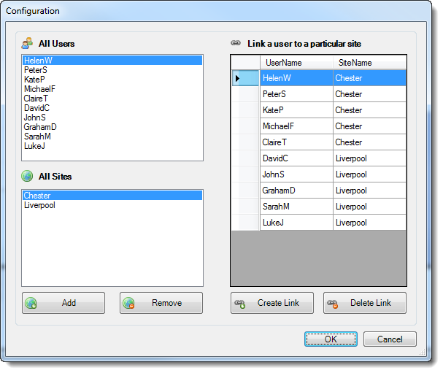
Management Metrics
Notes:
What’s in it for you?
Give you access to the management data that Remote Sampler collects
Saves you time over collating performance stats manually and putting them into Excel
Key metrics like:
Total number of samples completed by a user in a given period
Total number of samples completed by a site in a given period
Cumulative sample completion
Generate
Features
Generates a wide variety of interactive charts
See how well your team are handling the sampling schedule
Breakdown by site
Chart performance statistics for individual users
Control the display colours
Print the charts
Chart data that LIMS doesn’t hold
Integrates fully into Remote Sampler
Copy charts straight into Word or Excel

Slide 14
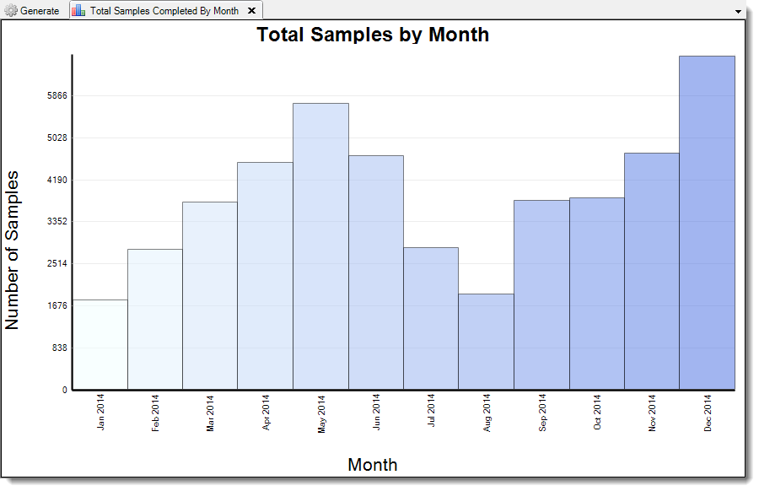
Management Metrics
Notes:
What’s in it for you?
Give you access to the management data that Remote Sampler collects
Saves you time over collating performance stats manually and putting them into Excel
Key metrics like:
Total number of samples completed by a user in a given period
Total number of samples completed by a site in a given period
Cumulative sample completion
Generate
Features
Generates a wide variety of interactive charts
See how well your team are handling the sampling schedule
Breakdown by site
Chart performance statistics for individual users
Control the display colours
Print the charts
Chart data that LIMS doesn’t hold
Integrates fully into Remote Sampler
Copy charts straight into Word or Excel

Slide 15
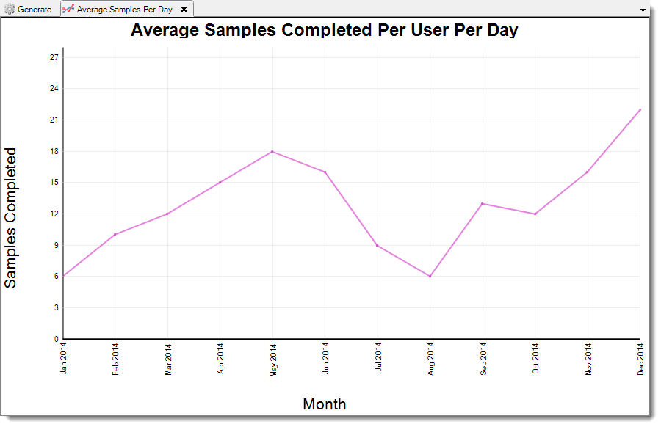
Management Metrics
Notes:
What’s in it for you?
Give you access to the management data that Remote Sampler collects
Saves you time over collating performance stats manually and putting them into Excel
Key metrics like:
Total number of samples completed by a user in a given period
Total number of samples completed by a site in a given period
Cumulative sample completion
Generate
Features
Generates a wide variety of interactive charts
See how well your team are handling the sampling schedule
Breakdown by site
Chart performance statistics for individual users
Control the display colours
Print the charts
Chart data that LIMS doesn’t hold
Integrates fully into Remote Sampler
Copy charts straight into Word or Excel

Slide 16
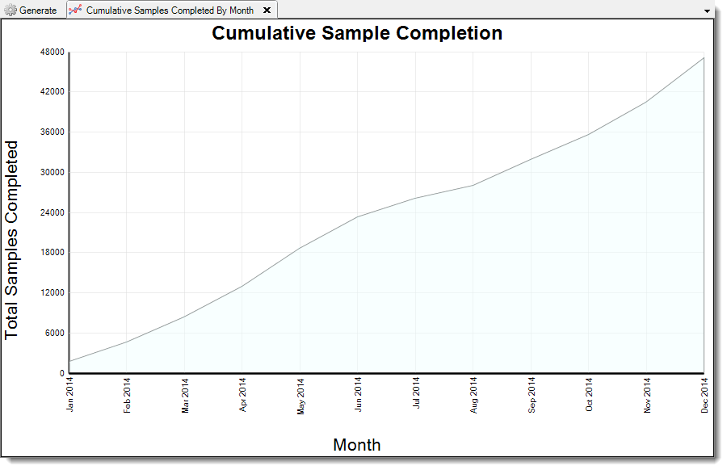
Management Metrics
Notes:
What’s in it for you?
Give you access to the management data that Remote Sampler collects
Saves you time over collating performance stats manually and putting them into Excel
Key metrics like:
Total number of samples completed by a user in a given period
Total number of samples completed by a site in a given period
Cumulative sample completion
Generate
Features
Generates a wide variety of interactive charts
See how well your team are handling the sampling schedule
Breakdown by site
Chart performance statistics for individual users
Control the display colours
Print the charts
Chart data that LIMS doesn’t hold
Integrates fully into Remote Sampler
Copy charts straight into Word or Excel

Slide 17
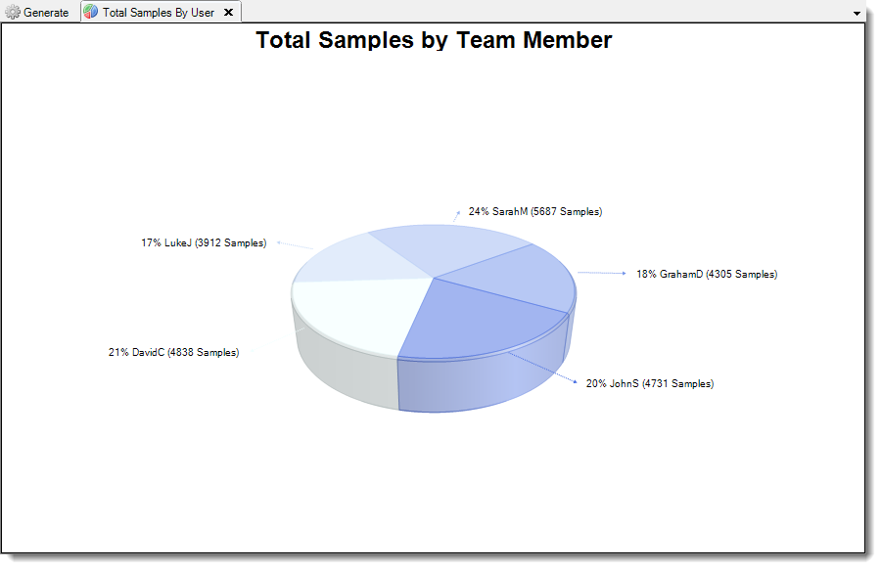
Management Metrics
Notes:
What’s in it for you?
Give you access to the management data that Remote Sampler collects
Saves you time over collating performance stats manually and putting them into Excel
Key metrics like:
Total number of samples completed by a user in a given period
Total number of samples completed by a site in a given period
Cumulative sample completion
Generate
Features
Generates a wide variety of interactive charts
See how well your team are handling the sampling schedule
Breakdown by site
Chart performance statistics for individual users
Control the display colours
Print the charts
Chart data that LIMS doesn’t hold
Integrates fully into Remote Sampler
Copy charts straight into Word or Excel

Slide 18
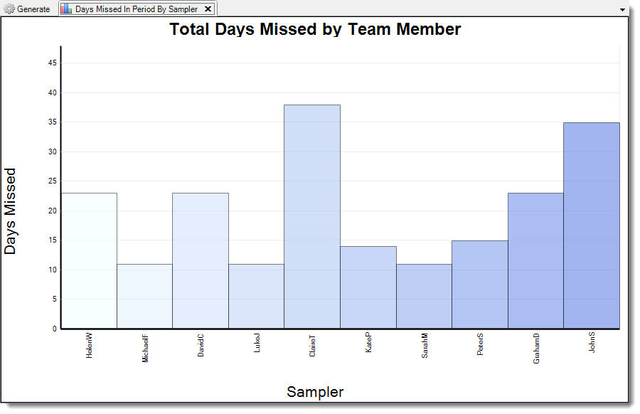
Management Metrics
Notes:
What’s in it for you?
Give you access to the management data that Remote Sampler collects
Saves you time over collating performance stats manually and putting them into Excel
Key metrics like:
Total number of samples completed by a user in a given period
Total number of samples completed by a site in a given period
Cumulative sample completion
Generate
Features
Generates a wide variety of interactive charts
See how well your team are handling the sampling schedule
Breakdown by site
Chart performance statistics for individual users
Control the display colours
Print the charts
Chart data that LIMS doesn’t hold
Integrates fully into Remote Sampler
Copy charts straight into Word or Excel

Slide 19
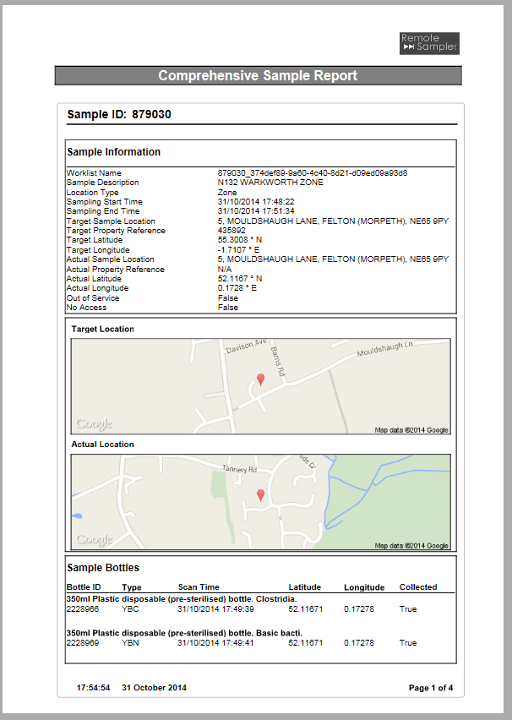
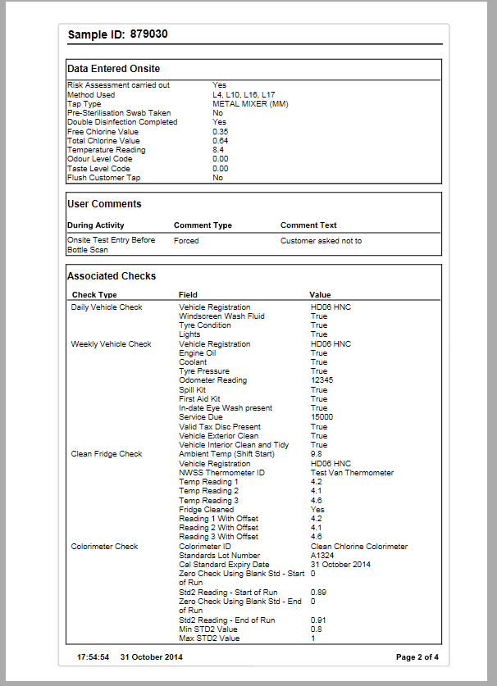
Chain of custody – Sample Report

Slide 20
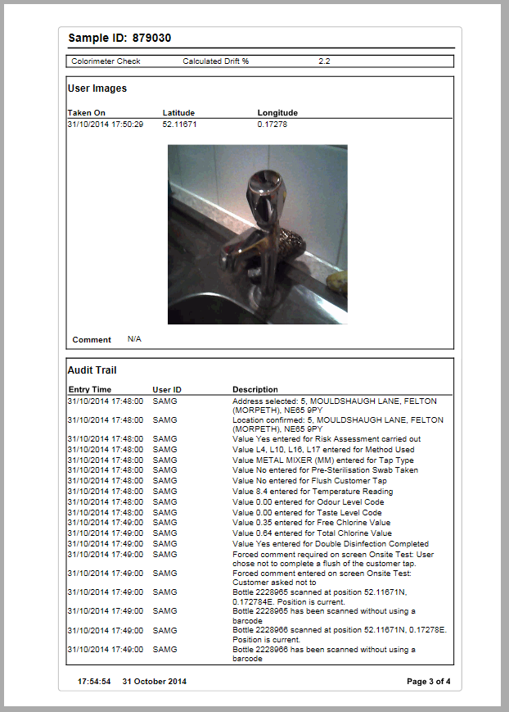
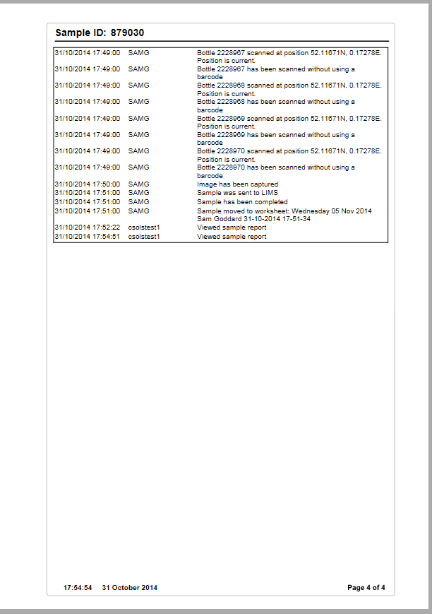
Chain of custody – Sample Report

Slide 21
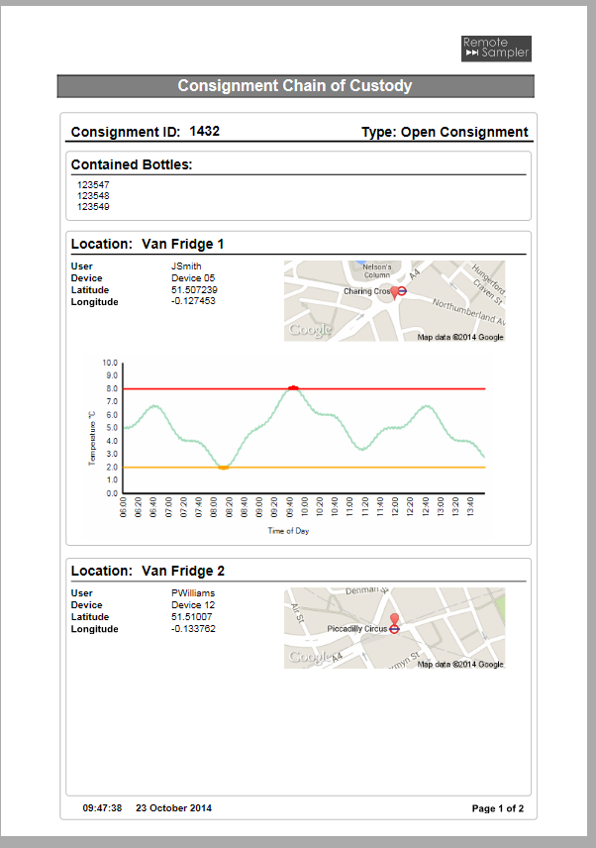
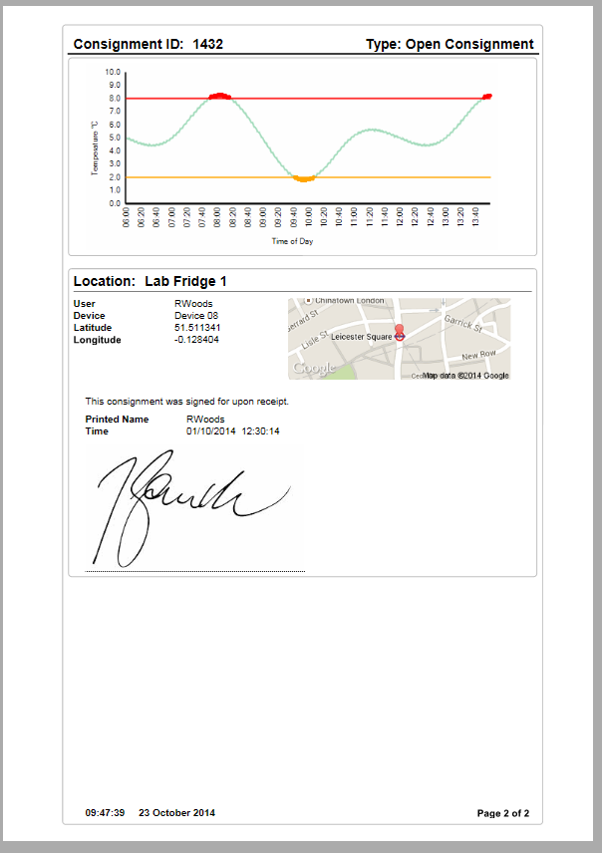
Enhanced Chain of custody

Slide 22
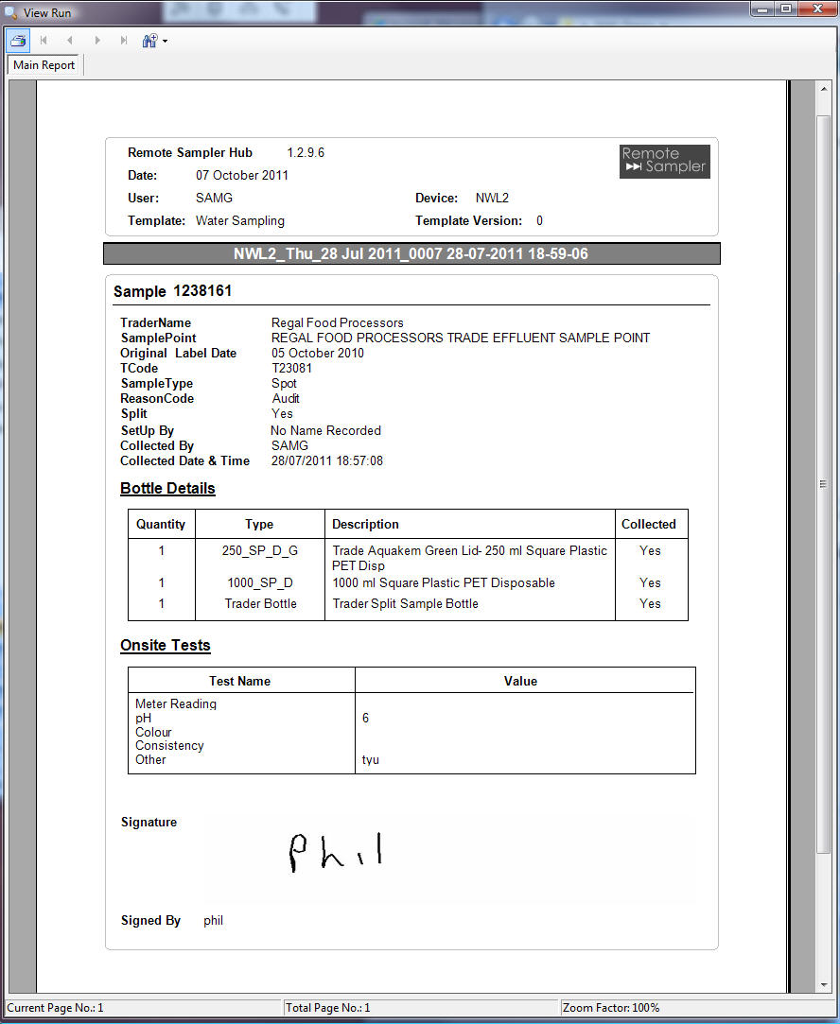
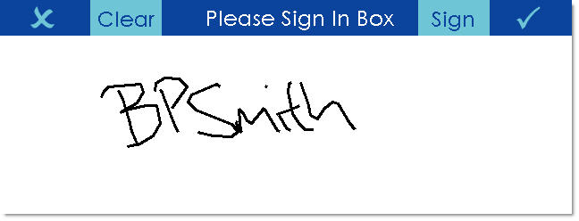
Trade sample transfer

