Slide 1
Beyond the technology
beyond the technology
Heartlands Instrument Integration
Vitamin D Workflow

Slide 2
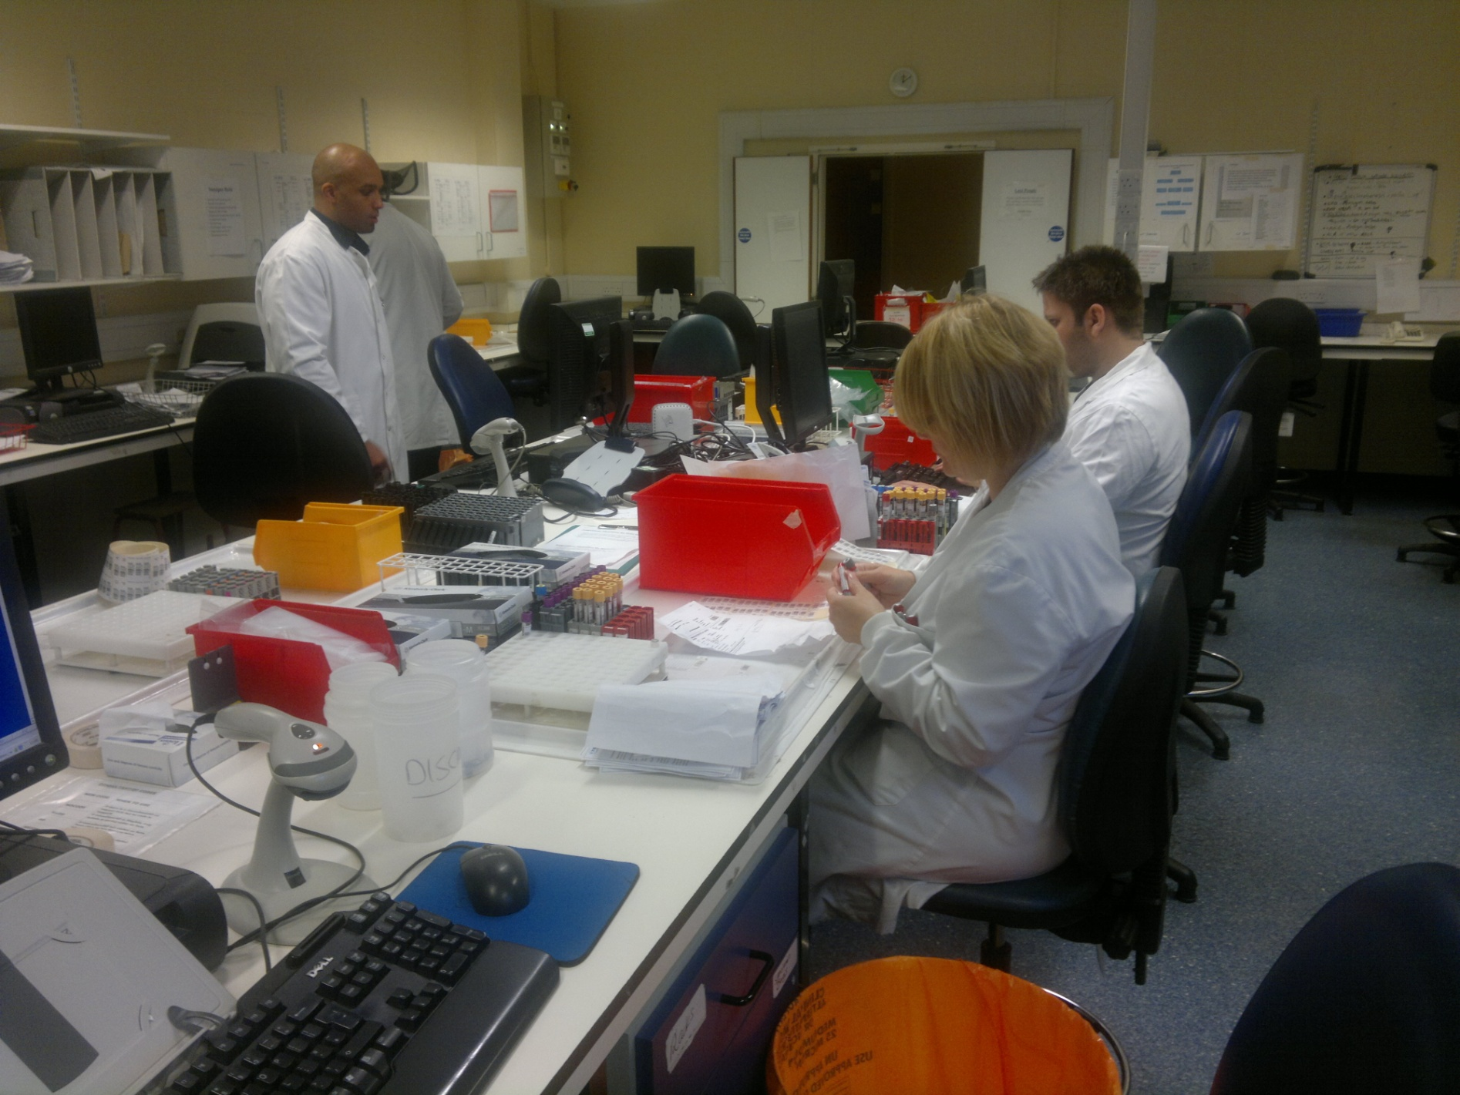
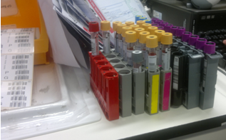
Step 1
Samples received in the pathology reception are checked, given unique barcode labels & then the new ids and patient details are registered in Telepath

Slide 3
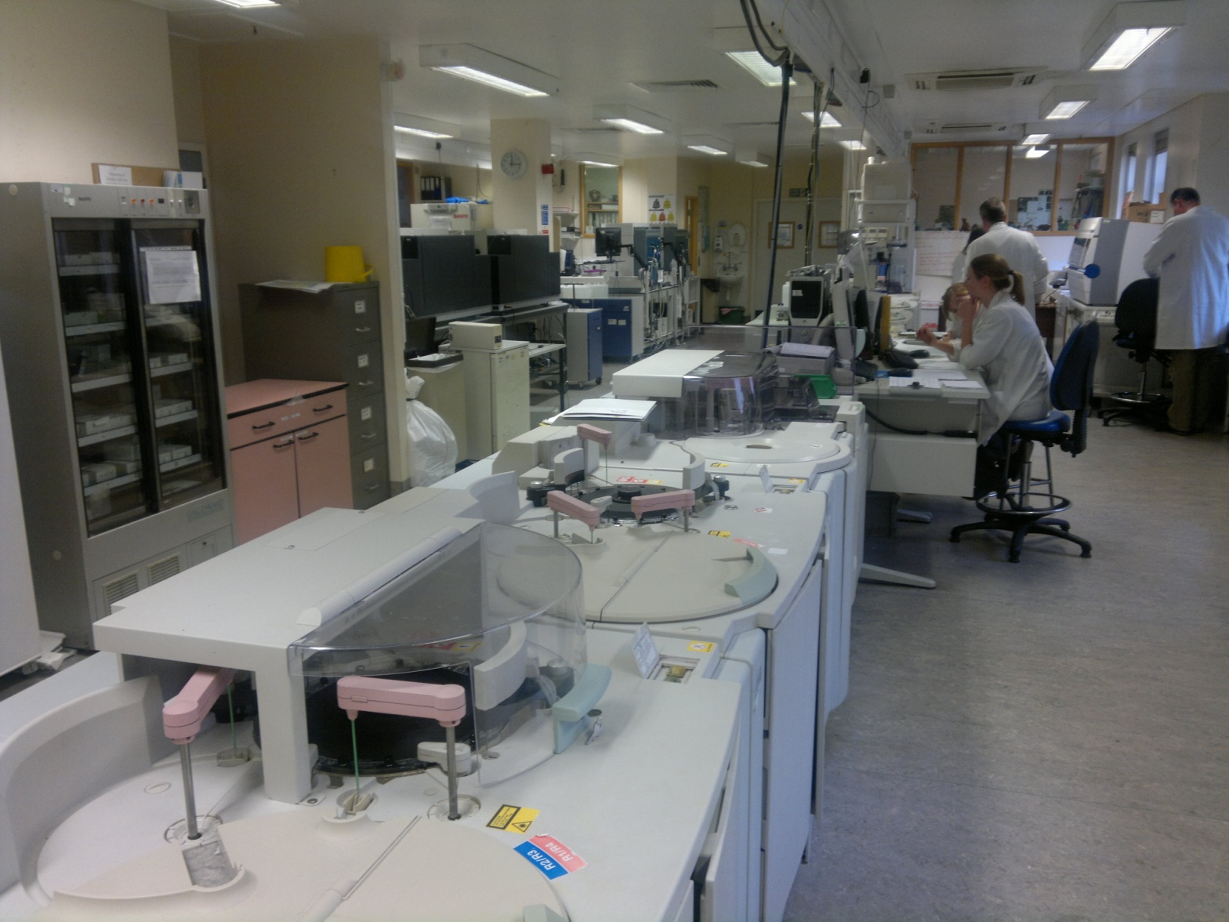
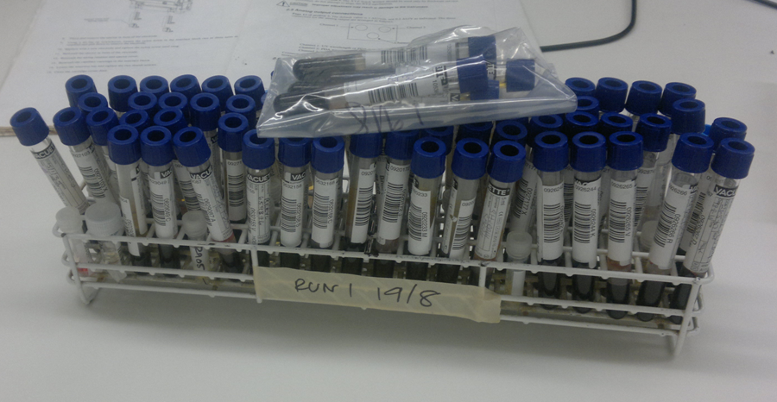
Step 2
Most samples arrive in biochemistry after being processed in the clinical chemistry unit.

Slide 4
Step 3
Samples are placed in 16 position racks on the Tecan robot for preparation e.g. Liquid-liquid Extraction for Vitamin D assay

Slide 5
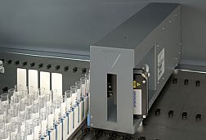
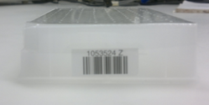
Step 4
The barcode reader mounted on the Tecan reads barcodes from the samples tubes and a unique label applied to the destination ‘deep well’ plate, before processing the samples. On completion the Tecan software produces a file linking the sample ids and their respective position in the destination plate.

Slide 6
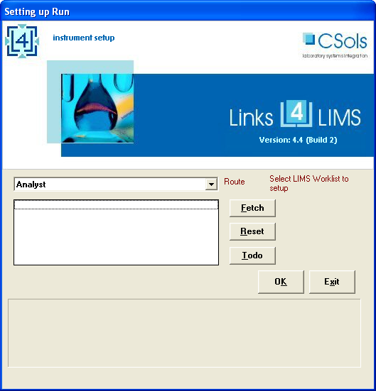
Step 5
User starts the Links for LIMS (L4L) software on the instrument workstation and the software ‘fetches’ the LIMS/LIS information for all the samples on the plate identified from the plate barcode label

Slide 7
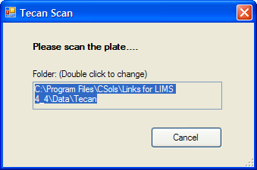
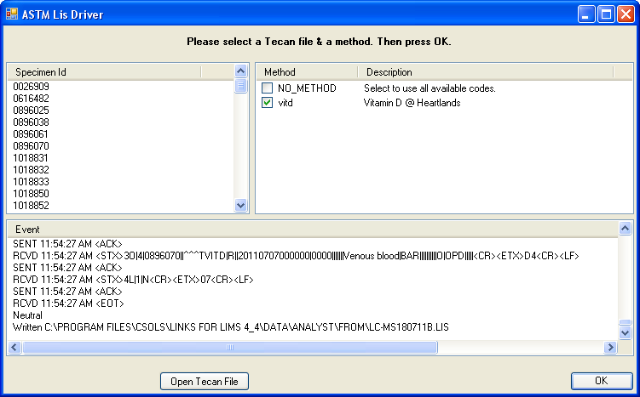
Step 6 L4L connects to Telepath, verifies the samples have been given this test and then fetches all the relevant patient information. Here the ASTM messaging protocol being used during transfer.

Slide 8
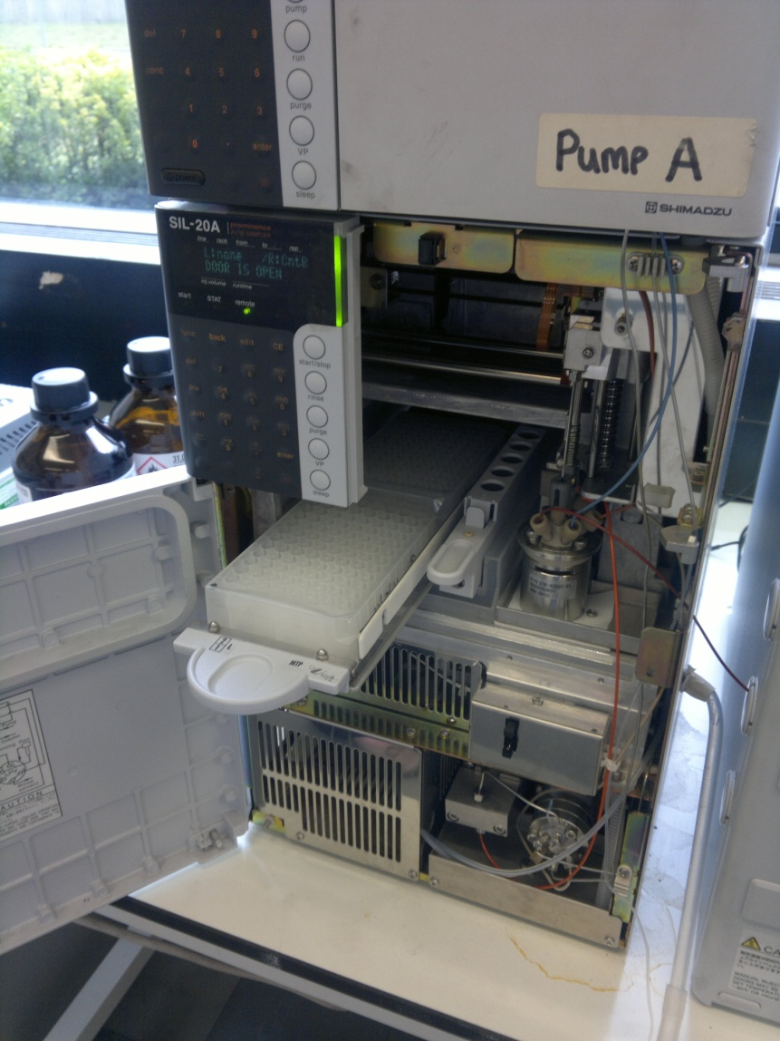
Step 7
The 96 well plate is placed in the AB Sciex LC-MS/MS instrument autosampler tray

Slide 9
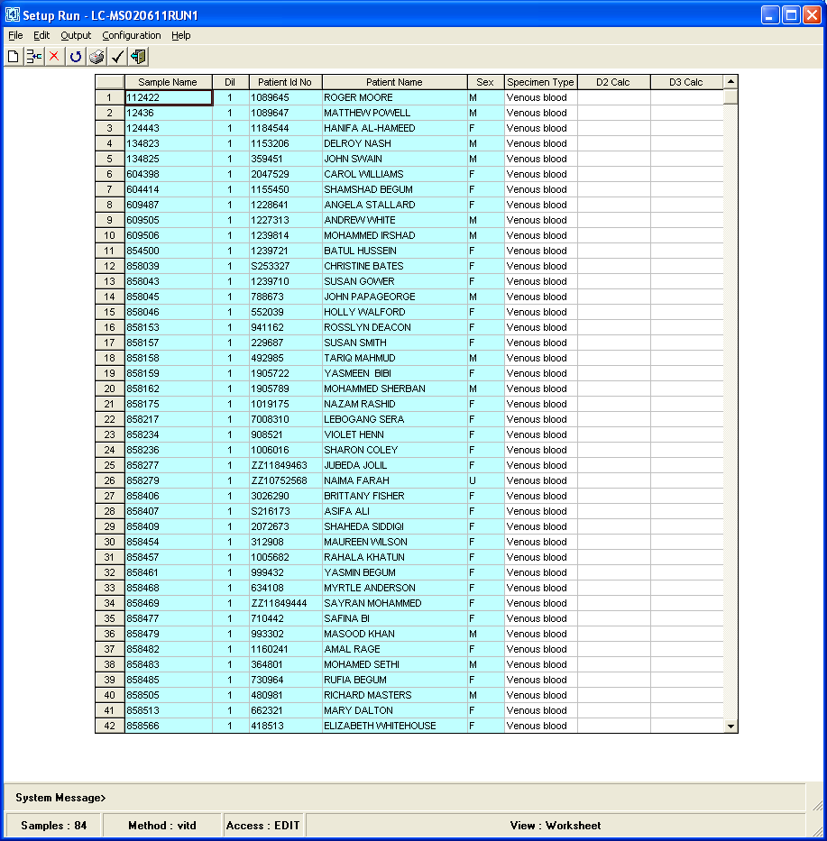
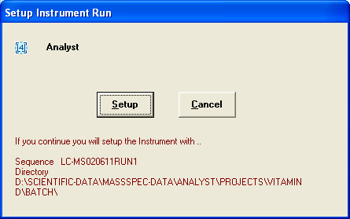
Step 8 User accepts the run, checks the samples are correct and then uses L4L to set up the instrument.
L4L electronically merges the new samples with a standard template file to create a run ready for use by the AB Sciex Analyst instrument software

Slide 10
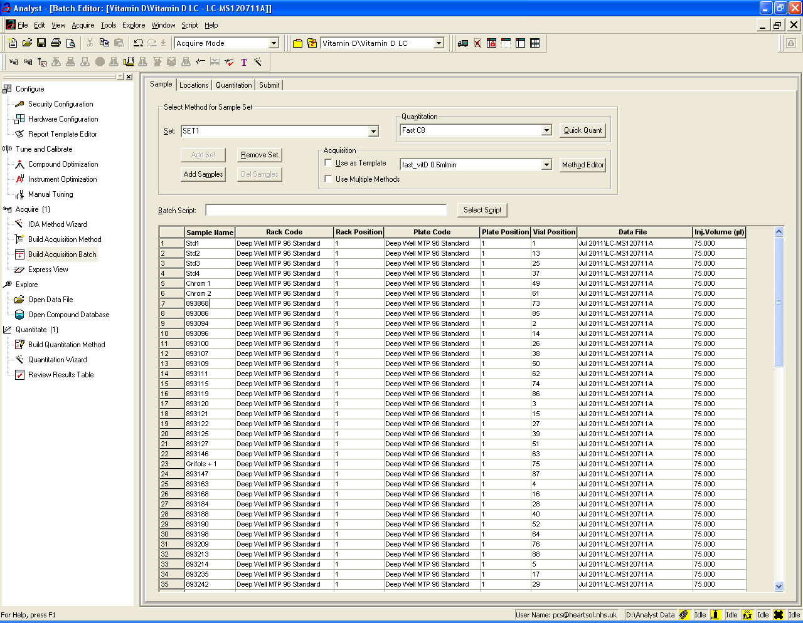
Step 9 User loads the L4L generated run into the Analyst software. Note position ordering in the template takes into account the differences between the autosampler and Tecan placement. L4L also provides file name and default entries so the user can start the run with no further need for data entry.

Slide 11
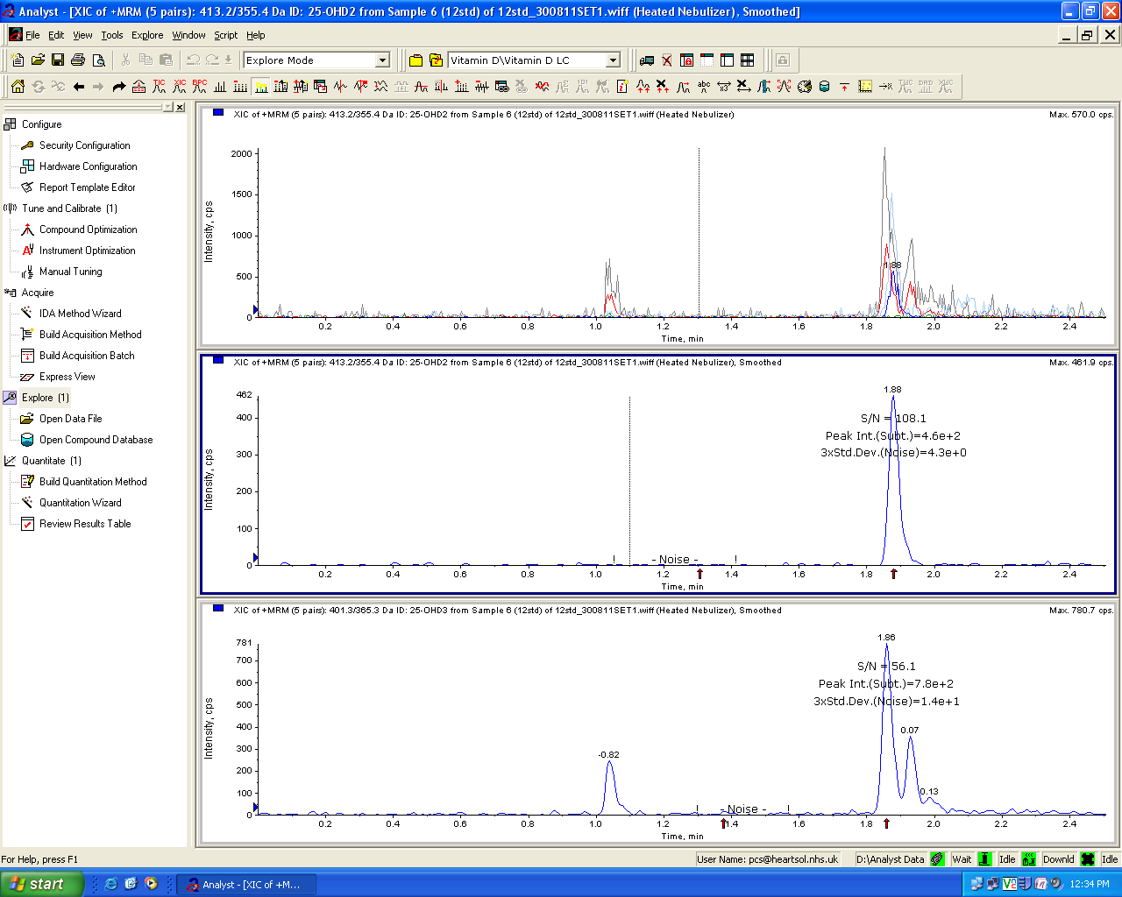
Step 10 The Instrument runs a full plate of samples (typically 80 samples on a 96 well plate)

Slide 12
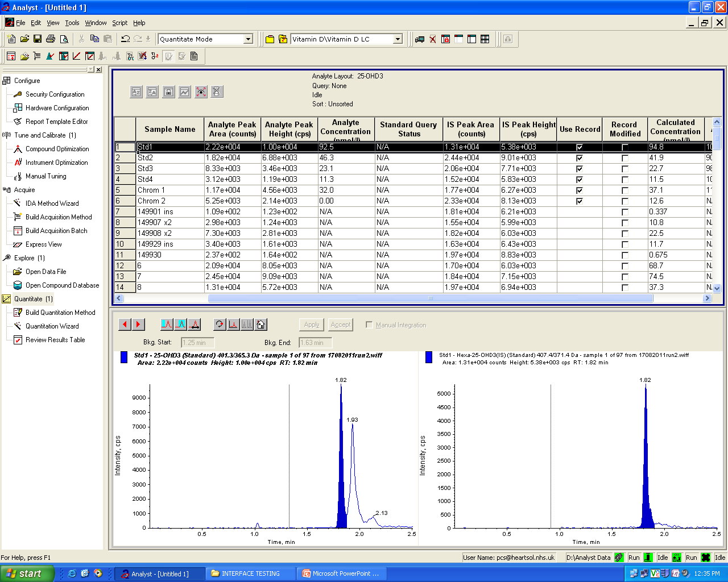
Step 11
User reviews the batch for correct integration using Analyst

Slide 13
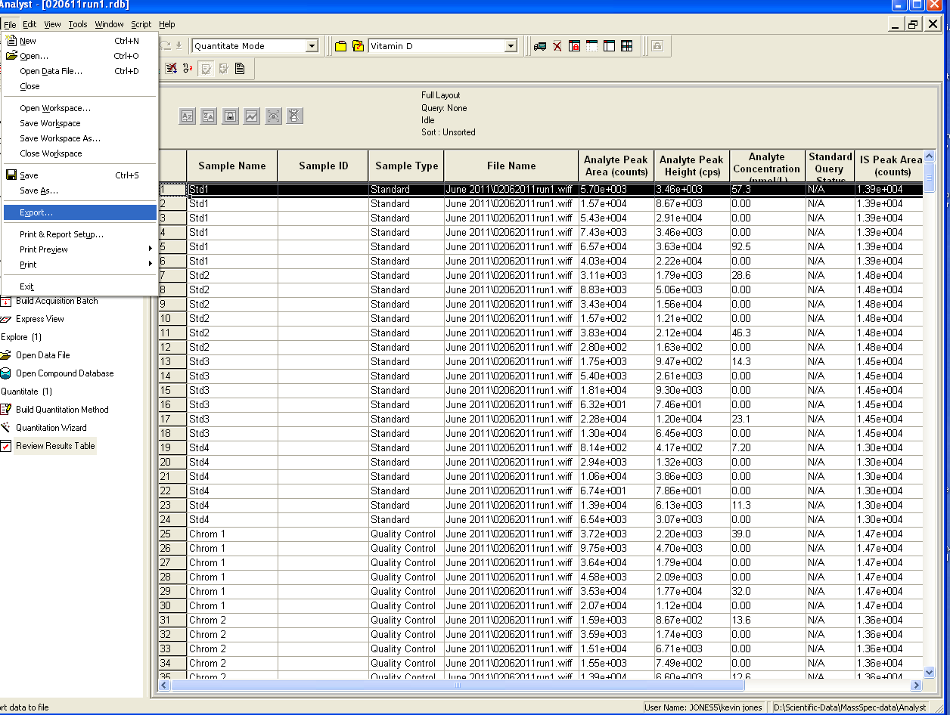
Step 12
The user then exports the results from Analyst.

Slide 14
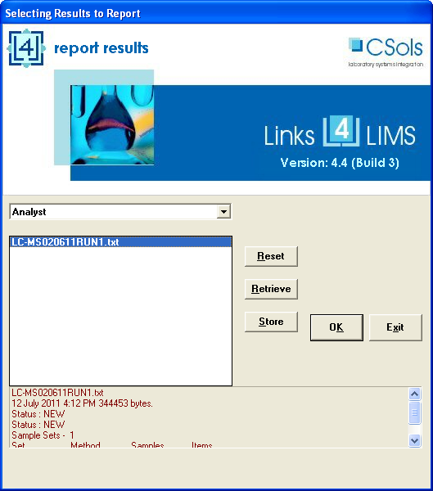
Step 13
The user then starts the L4L report result program and selects the run

Slide 15
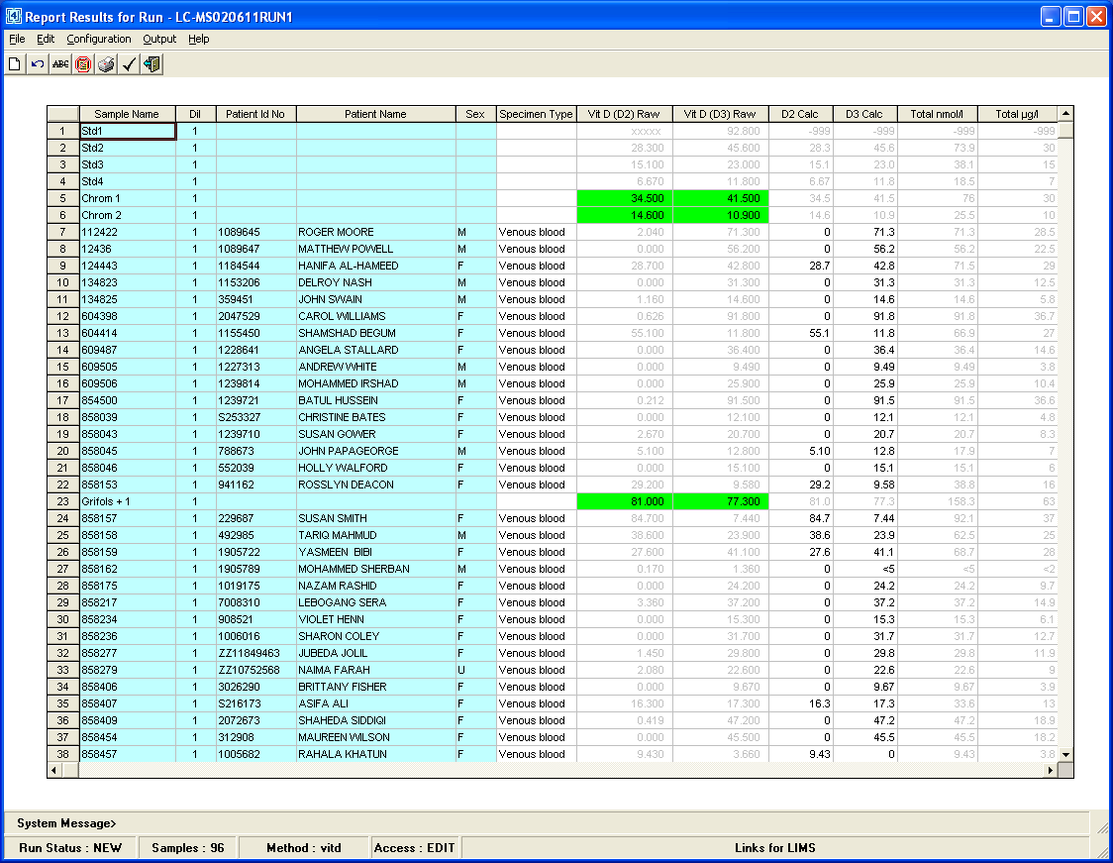
Step 14
As L4L imports the results data it pre-processes the results with rounding, calculations, logic and AQC checks. It then places all the results in a matrix format for review. Greyed out results are not requested by LIMS and provided for information only

Slide 16
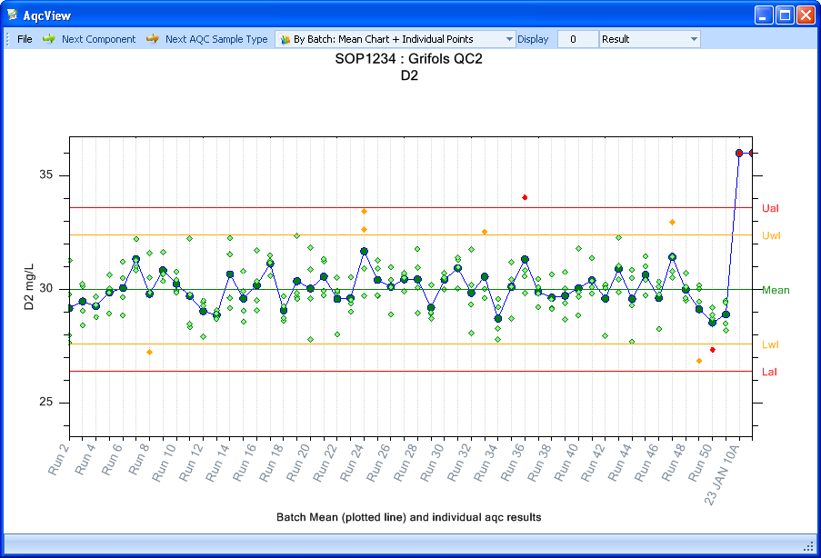
Step 15 In the event that AQC’s need to reviewed their results can be charted directly.

Slide 17
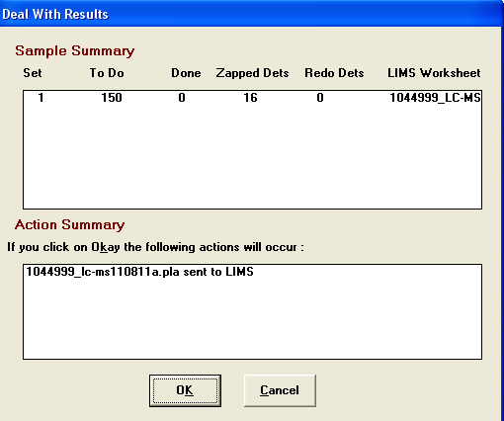
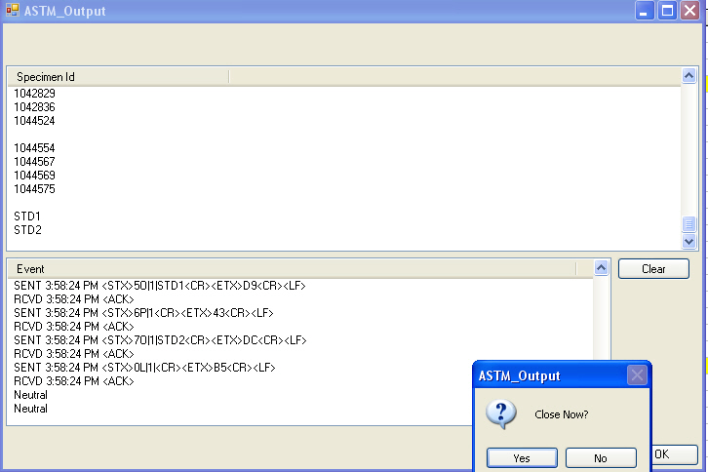
Step 16
Results in black meet AQC rules and can be sent to Telepath, while Suspect results can be ‘zapped’ or set aside for reanalysis in the next run.
L4L then opens a connection and Telepath and uploads all results electronically and then archives all the data files for later auditing

Slide 18
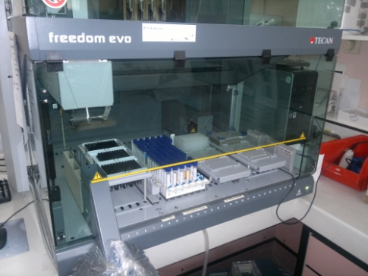
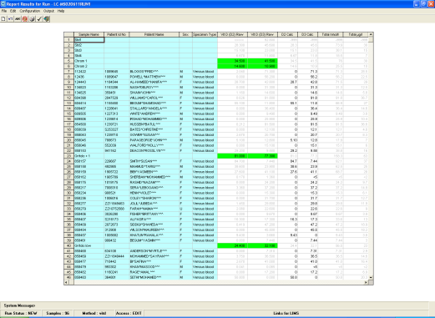
Summary
Sample Preparation
& Analyst time
Instrument set up
2 mins
Analyst time
2 mins
Instrument run
288 mins
Analyst Time
0 mins
Results review & upload
5 mins
Analyst time 5 mins

